Slide 1
Calibrating the E5071C Network Analyzers
1/24/13

Slide 2
Outline
Intro
First Look at Our Network Analyzers
Calibration Hardware
Cables: Pre-testing Before Calibration
Cal Kit Software in the Network Analyzer
Driving the Network Analyzer
1-Port & 2-Port Cals with 85033E Standards
Port Extension vs. Electrical Delay
Verifying Your Cal is Good: Measuring Something Else
Custom Cal Standards and User Cal Kits

Slide 3
Intro
Dr. Joel Dunsworth from Agilent visited us (EE142/242 class) on 11/30/12 and helped get some problems resolved in the lab. He had been instrumental with the donation of four E5071C network analyzers (ENA series) in 2007, but by 2012, a number of problems with the equipment had arisen and there were issues with getting Lab 1 (characterization of passive components at high frequency) to work. Specifically, the ECal had broken and the mechanical calibration standards we were using weren’t right. He gave us tutorials on calibration and on the measurement techniques to use for Lab 1, and during this process uncovered a number of problems with the equipment. We videotaped everything he said in the 3.5 hours he spent in the lab with us.
The remainder of the slides in this file are an extraction from that video of the knowledge he conveyed to us about how to ensure the calibration standards and final calibration results are correct. Most of the problems having to do with Lab 1 not working were due to the fact that we never had a good cal on any of the network analyzers the entire semester.
Joel Dunsmore has a new book: Handbook of Microwave Component Measurements. A copy is kept in the EE142/242 lab in Cory 111. Much of the information in these slides is in that book.
*Agilent is what used to be Hewlett-Packard’s test equipment division. HP spun it out in 1999. All the manuals for old HP
test equipment and calibration standards are on the Agilent web site. Application notes on how to really use network analyzers are on there also: http://na.tm.agilent.com/pna/help/latest/Tutorials/App_Notes.htm There’s also a forum here: http://prdportal.cos.agilent.com/owc_discussions/category.jspa?categoryID=32&start=1305
**The manual for the E5071C itself is in the analyzer. Just press the Help hard key.

Slide 4
What is a network analyzer?
...it’s an instrument that provides a frequency-swept signal to a 2-port network and
measures the resulting S-parameters (caveat: more expensive network analyzers can measure networks which have more than 2 ports). S-parameters imply that a 50 ohm load is built into each network analyzer’s port. 50 ohm port impedance makes high-frequency measurements viable. Network analyzers are designed to accurately measure the ratios of the reflected signal to the incident signal and the transmitted signal to the incident signal.
Why do we need to calibrate the network analyzer?
... because it has errors, and because we are usually adding cables to the ports on the analyzer. We don’t want the effects of the cables to contaminate the measurements of our circuit under test. To calibrate means to move the reference plane for the measurements (the position of zero phase, zero loss, zero mismatch) to the tips of the cables.
What is calibration?
... it’s the process of setting up the network analyzer so it knows how to correct for its own errors and for the effects of any cables. To do a calibration you have to use calibration standards. Calibration standards come in sets for different types of connectors. Calibration standards are basically pre-measured precisely-known devices. Along with those hardware calibration standards, there also has to be a software cal kit loaded into the analyzer which contains their parameters. You calibrate by attaching the various Short, Open, Load, & Thru standards to your cables and then pressing a bunch of buttons on the Calibrate menu. When you push Done, the analyzer calculates the correction coefficients it will apply to all subsequent measurements.

Slide 5
Lingo: “calibration” vs. “error correction”
With network analyzers, when we use the term calibration, we’re not talking about the type of calibration where you send the test equipment back to the factory once a year to get it tweaked up to its initial factory-new performance.
For network analyzers, we’re talking about the type of calibration that is done as you use the equipment with your specific test cables in any given session. You’ll take a bunch of measurements of calibration standards that you’ll attach to the ends of your test cables, in order to acquire the necessary correction coefficients that will subsequently get applied to your measurements of your device under test.
If you change the sweep settings, or put on different cables, you need to redo your calibration. This process is more accurately termed “error correction acquisition”, but the verbal shorthand of “calibration” is what we often use.
There is a basic factory cal that comes up whenever you hit the Preset hard key, but you still need to do your error-correction cal at the beginning of every session.

Slide 6
Pre-Test Before Error-Correction Cal
Joel Dunsmore recommends a strategy of always doing a pre-test before you start a measurement session with your error-correction cal. That is, since the network analyzer should come up after hitting the Preset button into a factory-default calibration, you should have an analyzer that has a somewhat decent cal. In this state, you can perform some initial measurements for a sanity check, which can save you lots of time and aggravation.
For instance, you can determine if your cables are stable and repeatable vs. whether or not you should throw them out (an error-correction cal can’t compensate for these types of cable problems).
As another example, a pre-test with your device under test (DUT) can show you the amount of noise on your trace and if you need to set up your analyzer (before you do your error-correction cal) to have a smaller measurement IF bandwidth. Reducing the measurement IF bandwith reduces noise. You need to set this IF (intermediate frequency) bandwith before you perform your error-correction cal at the beginning of your measurement session.

Slide 7
Outline
Intro
First Look at Our Network Analyzers
Calibration Hardware
Cables: Pre-testing Before Calibration
Cal Kit Software in the Network Analyzer
Driving the Network Analyzer
1-Port & 2-Port Cals with 85033E Standards
Port Extension vs. Electrical Delay
Verifying Your Cal is Good: Measuring Something Else
Custom Cal Standards and User Cal Kits

Slide 8
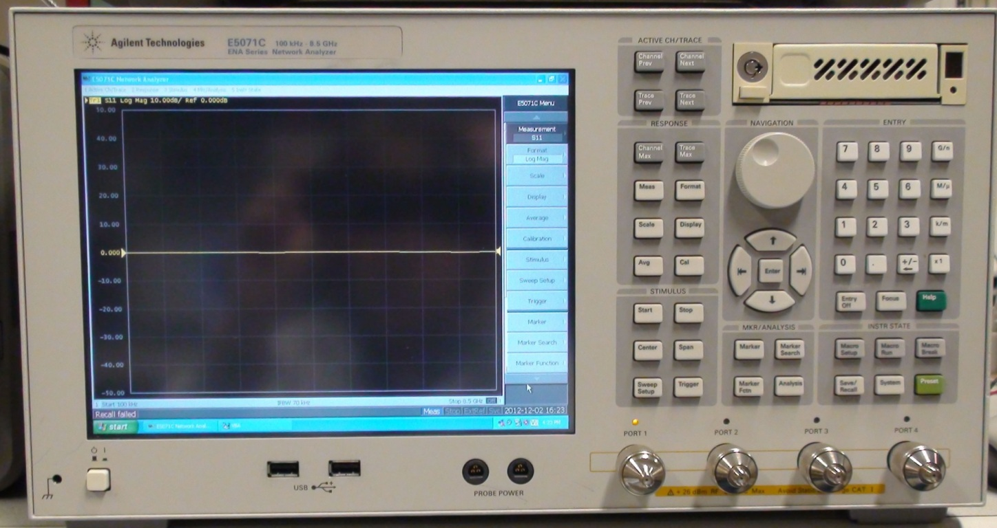
First Look at our Network Analyzers
*Agilent puts out firmware updates for these network analyzers. The latest firmware fixes can be downloaded from here:
http://www.home.agilent.com/agilent/software.jspx?ckey=879905&lc=eng&cc=US&nid=-11143.0.00&id=879905

Slide 9

We have the ENA series of network analyzers from Agilent. This one is the 4-port E5071C
which can sweep from 100 kHz to 8.5 GHz. Turn it on. The screen looks like this - a LogMag trace of S11 (in dB) on the y-axis (10 dB/division) vs. frequency:
Always keep your eye on this lower right corner. If you’ve calibrated and you have error correction on, it will say “Cor”.
Down-arrow icon is for scrolling down through the remainder of this soft-key menu.
Hit the green Preset hard key at lower right, which will bring up a softkey menu that asks you to confirm. Hit okay. That will put the network analyzer in a known factory-default state. The operating system is Windows. Hitting the Help hard key, brings up context-sensitive Help on the analyzer’s screen.

Slide 10
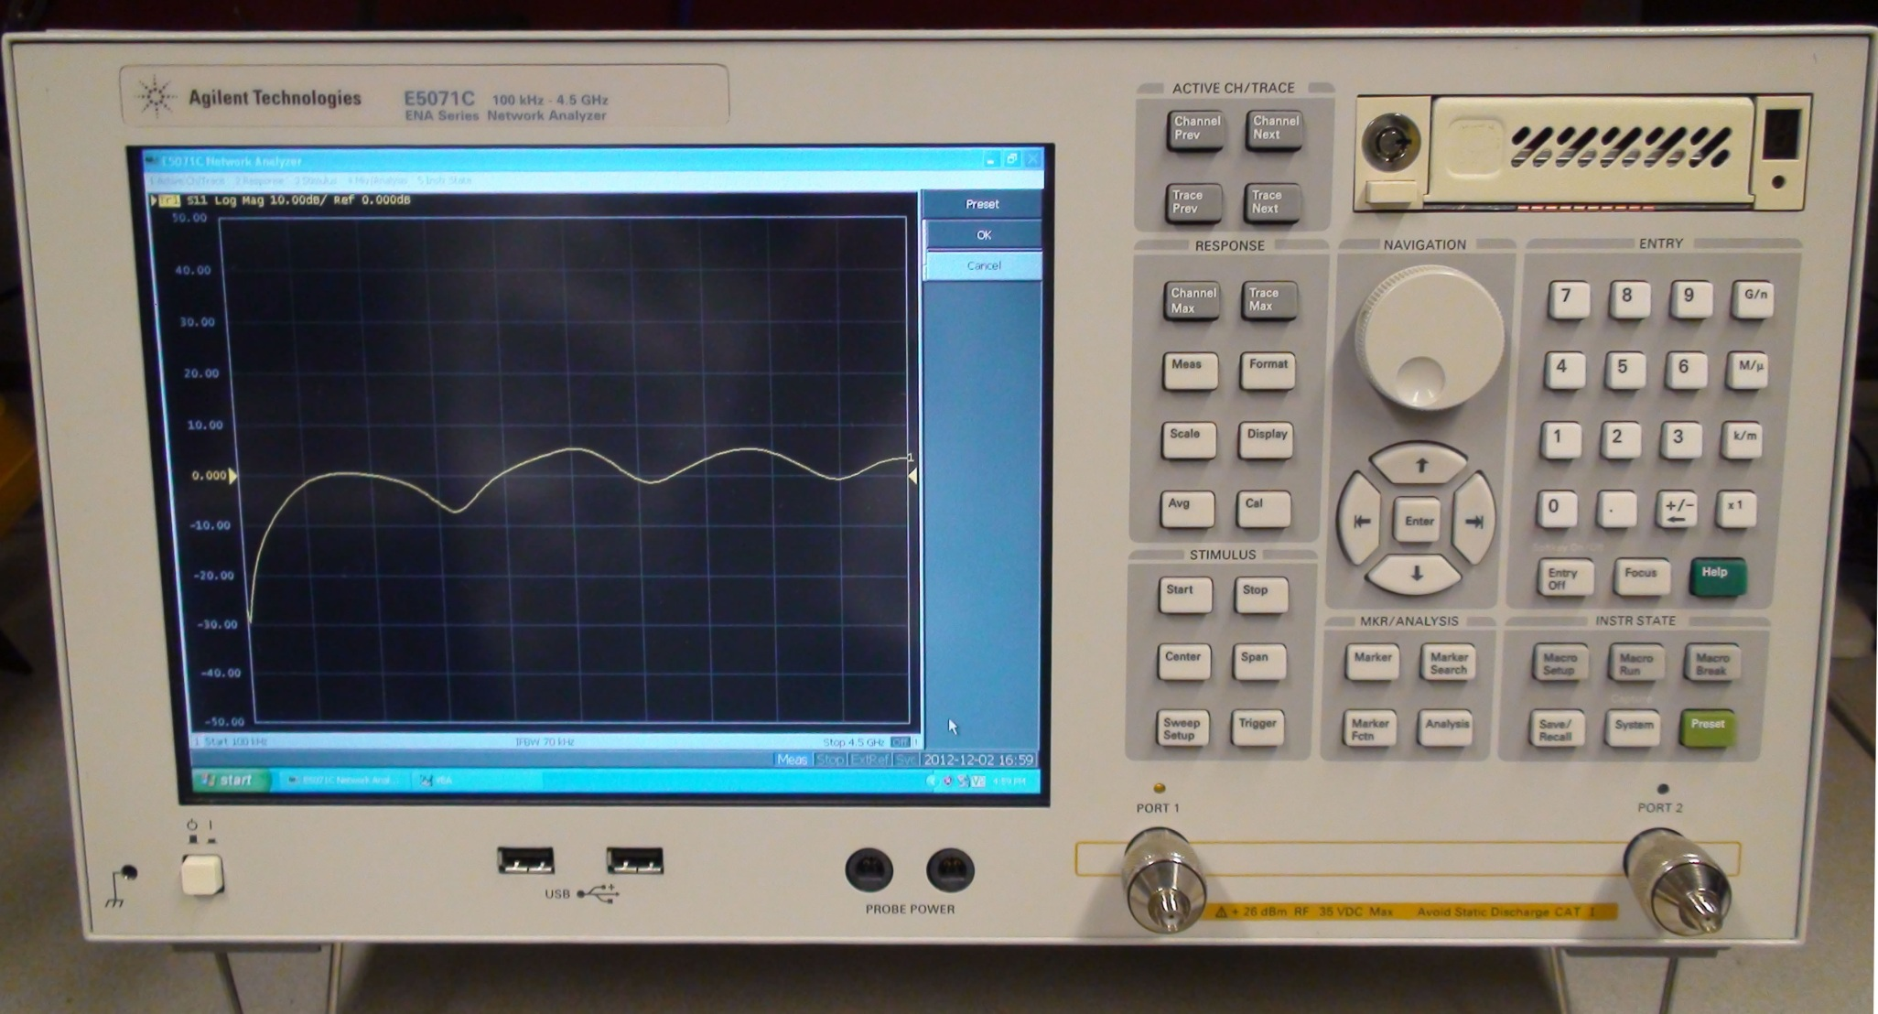
This is one of 3 other network analyzers in the lab which are 2-port instruments. These
sweep from 100 kHz to 4.5 GHz. This one came up looking like this. I just hit the Preset button. Now touch OK on the soft-key menu. It still looks like this:
This looks way out of the factory default calibration. Gain with nothing connected? I sent a pic to Agilent tech support. They said it’s just plain broken. (Even though I’m able to calibrate it, they said the calibration will surely try to compensate for this, but you’ll lose dynamic range on subsequent measurements.) They said we need to send it in for repair ... probably a bad sampler on the reference signal.
Preset button

Slide 11
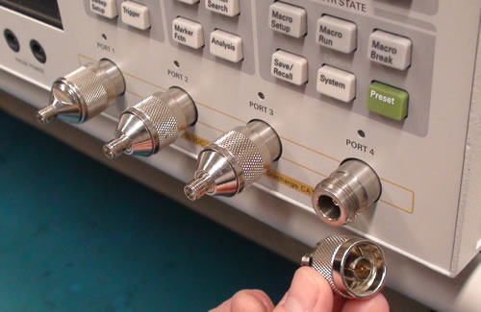
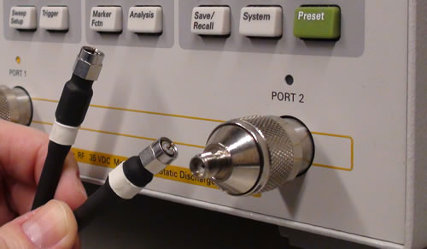
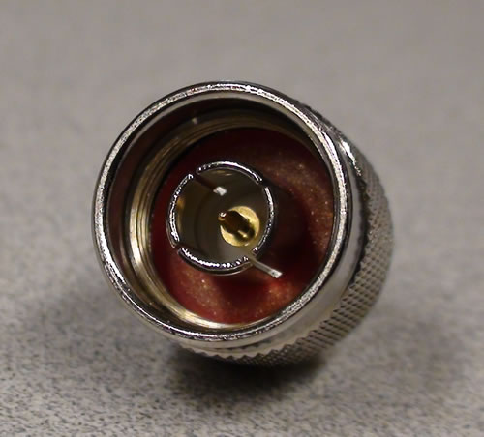
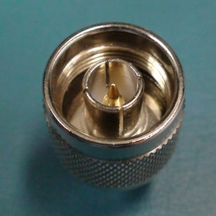
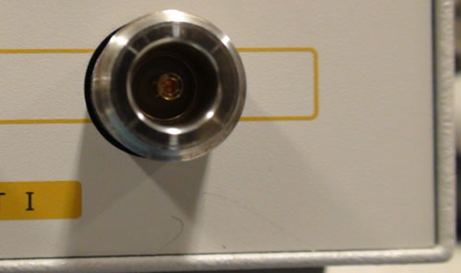
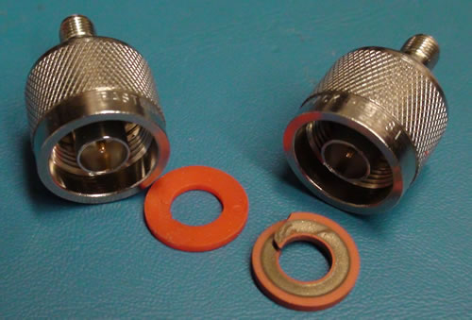
Our network analyzers have female N connectors, to which we usually attach male-N-to-female-SMA adapters.
All of our coax cables are male-SMA-to-male-SMA cables.
The calibration reference plane of a male N connector is the plane coincident with the edge face of this metal ground ring surrounding the center signal pin.
The mating surface on the female connector is another metal ring down at the bottom. However, we won’t usually be calibrating directly at this port. We usually want to calibrate so as to move the calibration reference plane from this plane to the far end of our male-male SMA cables.
Make sure that none of the adapters have rubber gaskets down at their bottom. Those are made for outdoor applications and require a different torque setting. You can pull the gaskets out with tweezers. If they’re left in, and not fully torqued, they make poor (intermittent) connection and don’t work.

Slide 12
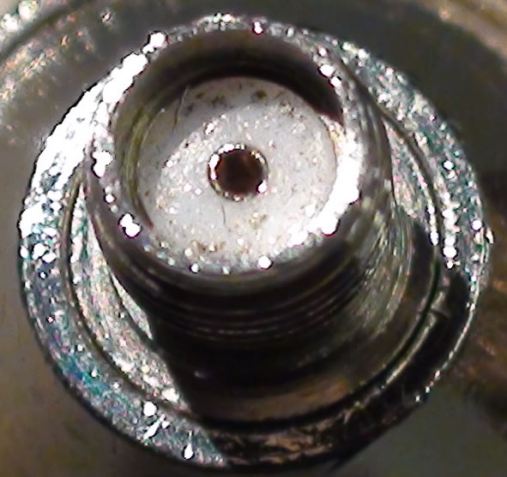
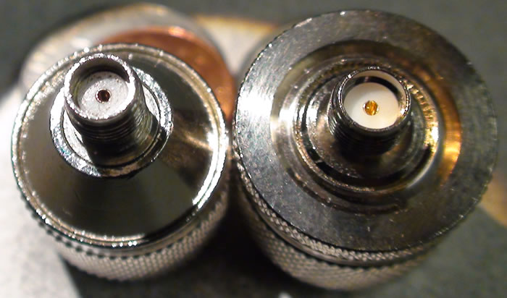
Inspect both ends of the male-N-to-female-SMA adapters.
Not just this male-N side
...but also the female-SMA side
Here’s an old adapter taken off of one of the analyzers in our lab. It’s probably been on there since the equipment was donated in 2007 (this picture is taken at the end of 2012). Notice all the bits of metal debris on the surface of the white plastic.
This is a brand new adapter.
Close-up of the old adapter. Time to clean it. All these metal bits change the electromagnetic environment from what we would assume to be a uniform transmission line of coax cable.

Slide 13
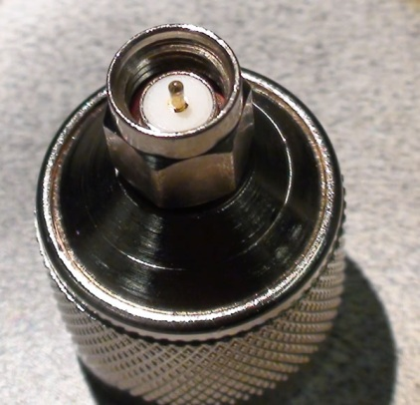
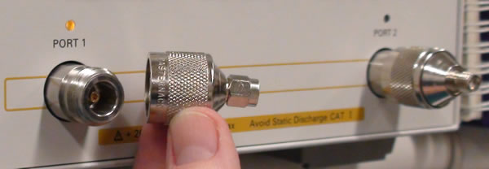
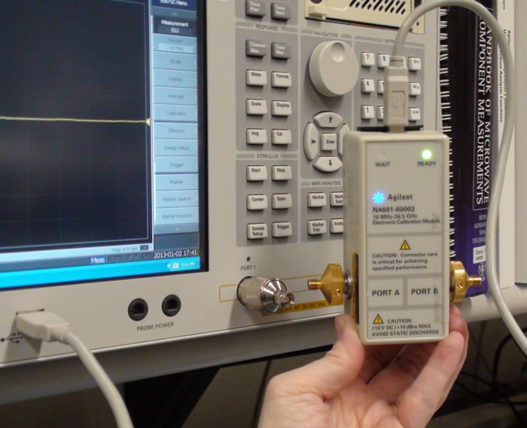
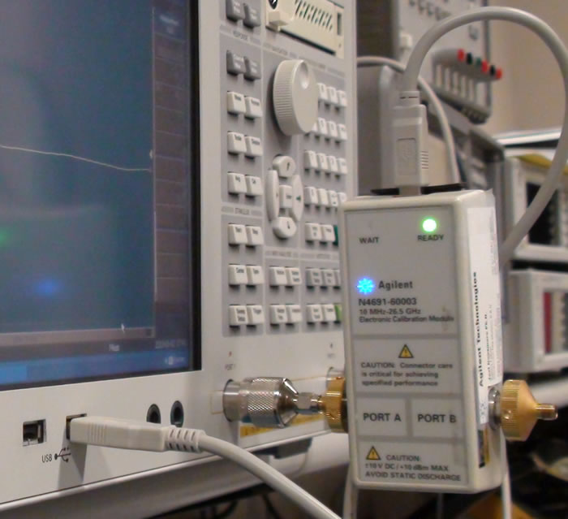
Sometimes however, we use male-N-to-male-SMA adapters ... for instance, when we want to test our test equipment.
At bottom right is an ECal (electronic calibrator), which has gold female connectors on each port.
male N side
male SMA side
These male-N-to-male-SMA adapters have rubber gaskets on the SMA side too. All SMA connectors have rubber gaskets, but SMA connectors have flats so are easier to tighten to their specified torque.
Specifications on torque:
N connectors: 12 in-lb
3.5 mm connectors: 8 in-lb.
SMA connectors: 5 in-lb.
The ECal can plug directly into the male-N-to-male-SMA adapter. I thought it would be good to test the Ecal this way, as it minimizes the number of cables, adapters and connectors. Unfortunately, I bought some cheap male-N-to-male-SMA adapters and they broke when I torqued them. It’s worth it to buy the more expensive male-N-to-male-3.5mm adapters that are made for test applications. Maury Microwave sells them for $80 - $200 each. Otherwise, stick with the male-N-to-female-SMA adapters.

Slide 14
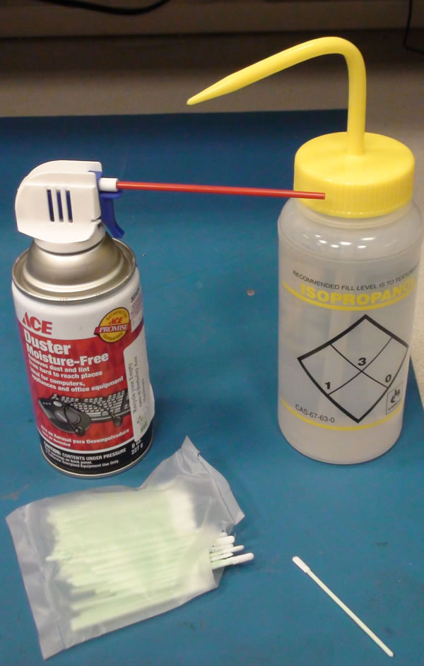
Clean the connectors by first blowing on them with a short burst of clean dry air. Cans are availalbe at Ace Hardware on University Ave. Use sparingly. Let’s make the cans last as long as possible.
Then, use a lint-free swab (you can buy them from Texwipes via Amazon) and moisten it with isopropyl alcohol. Look at the connector under a microscrope and brush the swab over the dielectric, around the center conductor.
Blow dry. Check again under the microscope to make sure they’re clean.
Also, make sure the connectors are dry before you thread them onto anything.

Slide 15
Outline
Intro
First Look at Our Network Analyzers
Calibration Hardware
Cables: Pre-testing Before Calibration
Cal Kit Software in the Network Analyzer
Driving the Network Analyzer
1-Port & 2-Port Cals with 85033E Standards
Port Extension vs. Electrical Delay
Verifying Your Cal is Good: Measuring Something Else
Custom Cal Standards and User Cal Kits

Slide 16
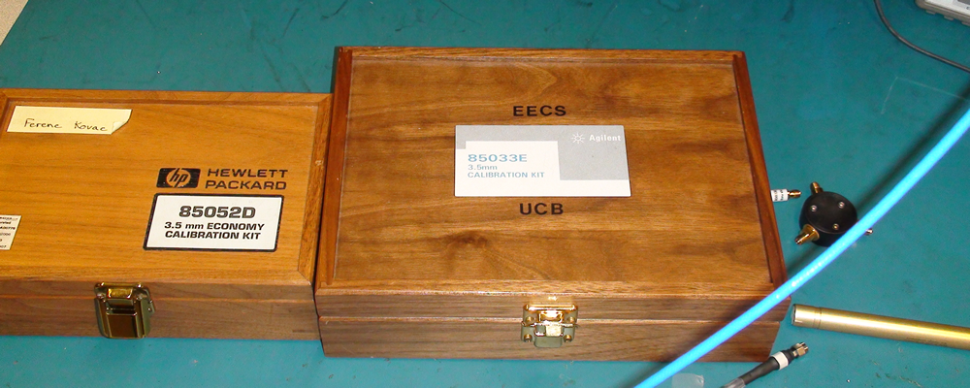
Calibration Hardware

Slide 17
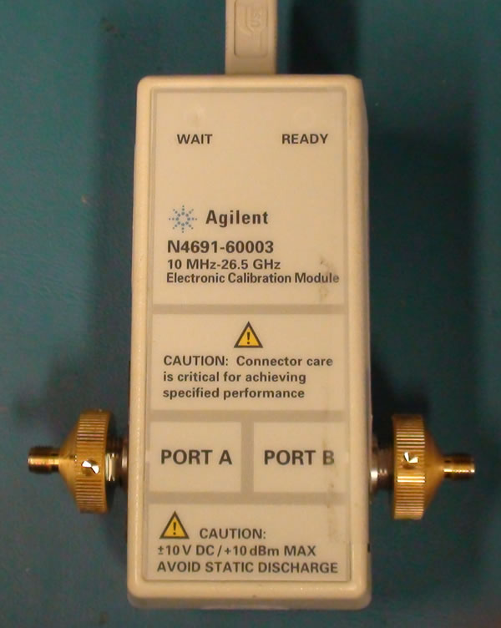
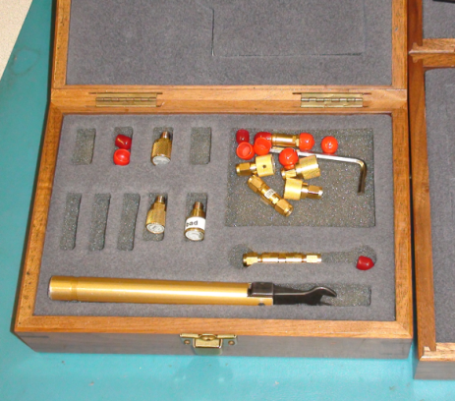
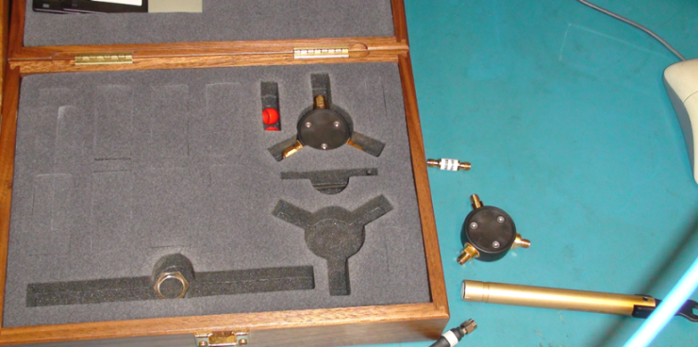
We have 1 electronic calibrator (Ecal) and 2 mechanical calibration kits: 85052D and 85033E. The 2 mechanical calibration standard sets come in both female and male 3.5 mm connectors. The inner diameter of the outer shield is 3.5 mm. These 3.5 mm connectors use air as the dielectric insulator between the center signal pin and the surrounding ground cylinder. 3.5 mm connectors mate with SMA (Sub-Miniature A) connectors. The only difference between the two types of connectors is that SMA connectors use a plastic teflon-like dielectric insulator.
People often use the verbal shorthand of “SMA” when referrring to a 3.5 mm connector, but they’re technically different. Because of their air dielectric, 3.5 mm connectors are rated to 26 GHz and used on test equipment for precision measurements. SMA connectors on the other hand, because of their plastic dielectric, are rated to only 18 GHz. However, SMA connectors are more widely used in commercial applications because they’re cheaper.
85033E 3.5 mm cal standards
85052D 3.5 mm cal standards
Ecal
(This is Joel Dunsmore’s that he lent us while ours is being repaired. This is model N4691-60003 which is spec’d to start at 10 MHz, whereas ours is the newer N4691-60006 which is spec’d to work as low as 300 kHz.)

Slide 18
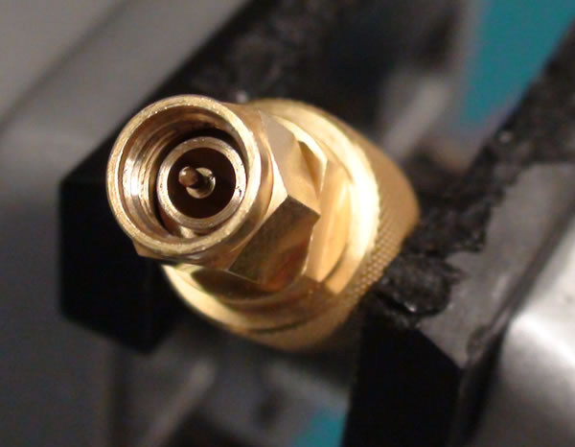
3.5 mm calibration standards
The actual coaxial transmission line consists of this outer ground cylinder here
... and this center signal conductor here. The dielectric between them is air, in a 3.5 mm connector (an SMA connector would have teflon for the dielectric).
This outer portion is the nut on this male connector. The nut is not actually part of the uniform transmission line (although it does connect electrically to the outer cylinder).
This inner diameter of the outer coax ring is 3.5 mm.

Slide 19
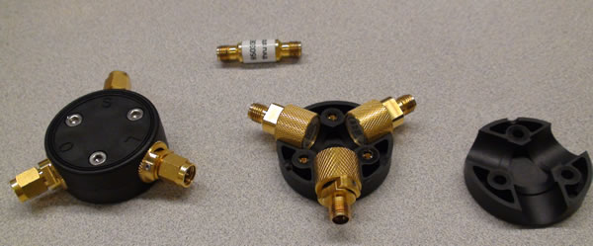
Calibration standards (from the 85033E kit): Short, Open, Load and Thru (SOLT)
The black plastic thing is just a holder which keeps the short, open and load standards of a kit together. It’s called an SOL holder.
Female-to-female 3.5 mm Thru standard
SOL labels
Male 3.5 mm Short/Open/Load standards have nuts which you can fit a torque wrench onto
Female 3.5 mm Short/Open/Load standards

Slide 20
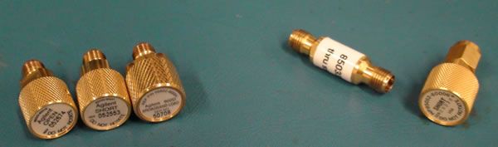
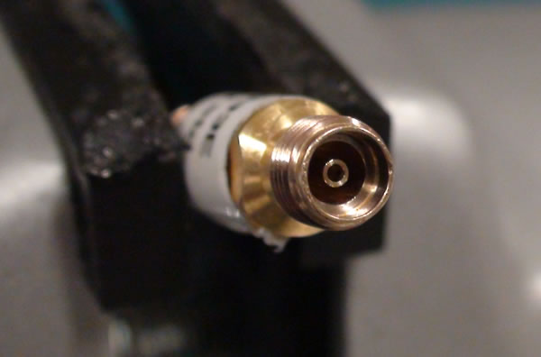
Female Open, Short, Load standards
Female-female Thru standard and male Short standard
Female 3.5 mm connector on one end of a Thru std
Male 3.5 mm connector on a Short std

Slide 21
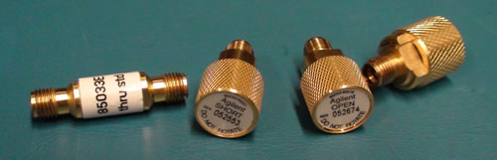
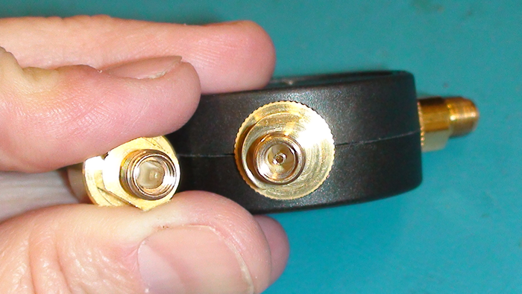
Get in the habit of looking carefully at the calibration standards before you use them. Look at them under the
stereo microscope, with the microscope light on. Hang the stereo microscope head over the edge of the table so you have plenty of distance to hold the standard and move your hands up and down to change the plane of focus so that you can see all the way to the bottom of these 3.5 mm connectors’ insides.
This Open is broken. It’s completely missing its insert. We wasted hours and hours trying to calibrate with no success, before we noticed.
A female standard should look like this. It should have this female center insert that accepts the male signal pin from the mating male connector.

Slide 22
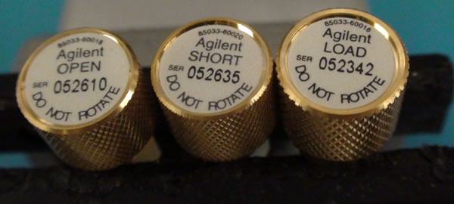
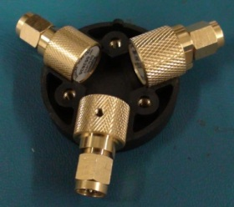
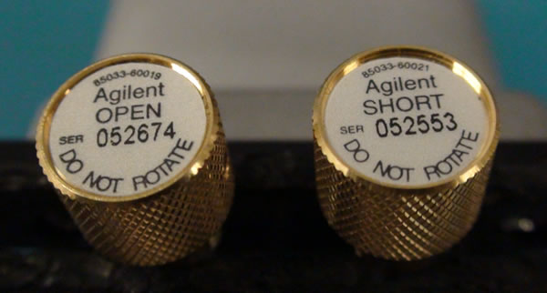
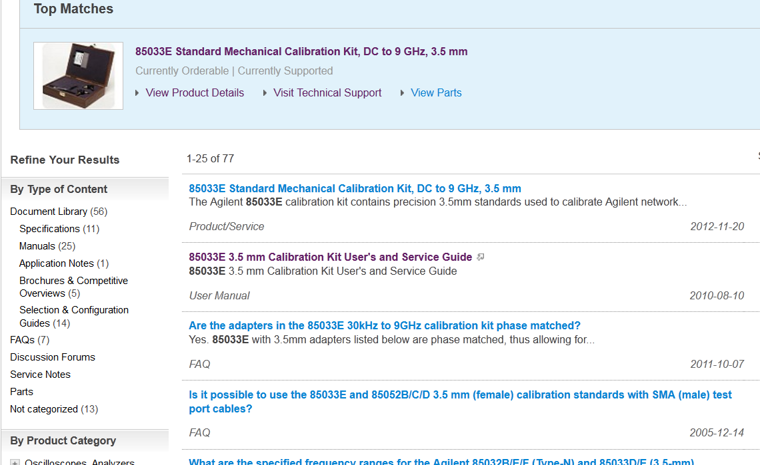
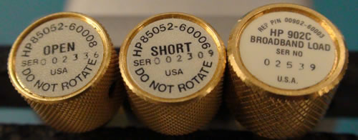
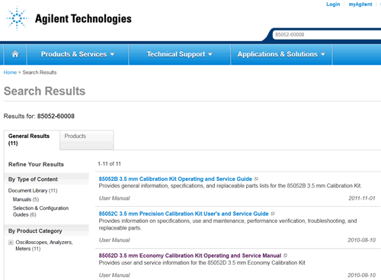
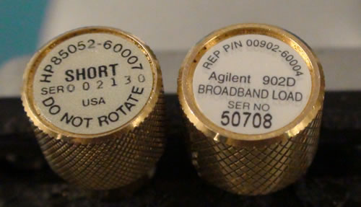
Part Numbers of the 10 Calibration Standards in Our Lab
Male 85033E standards
85033-60018
85033-60020
85033-60016
These are all the mechanical calibration standards we have in the Cory 111 (EE142/242) lab. They are all Agilent products (even the ones marked HP) and so can be looked up on the Agilent web page. The part number is this tiny number at the top left of each label.
Female 85033E standards
85033-60019
85033-60019
Male 85052D standards
85052-60008
85052-60006
902-60003
Female 85052 standards
85052-60007
902-60004

Slide 23
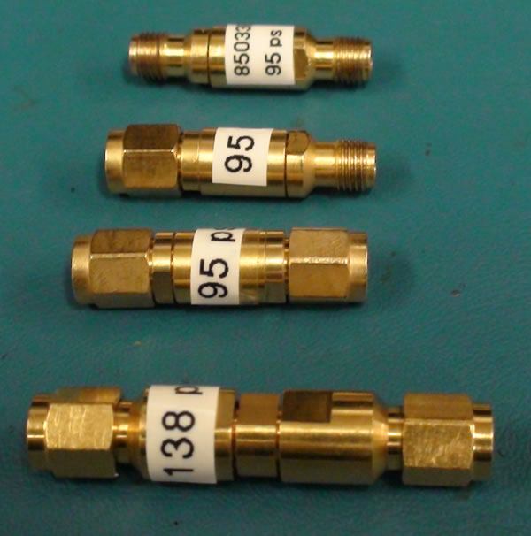
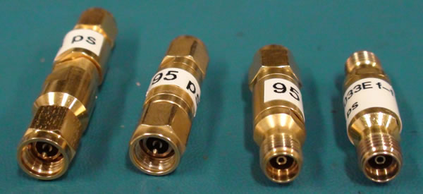
Adapters in the 3.5 mm Calibration Standards Kits
Female-female 3.5 mm adapter
95 ps delay
Male-female 3.5 mm adapter
95 ps delay
Male-male 3.5 mm adapters
95 ps delay
138 ps delay
You can tell these are 3.5 mm adapters (as opposed to SMA adapters) because the dielectric is air rather than plastic.

Slide 24
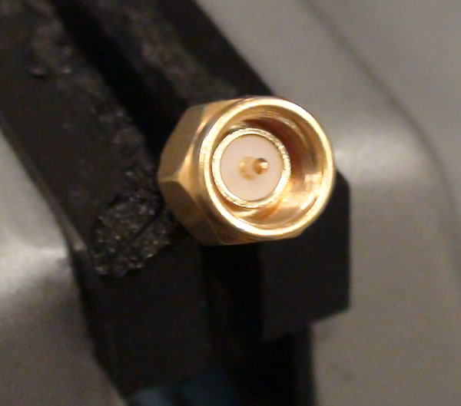
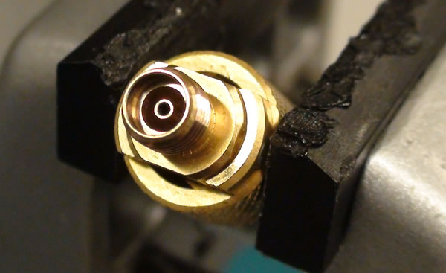
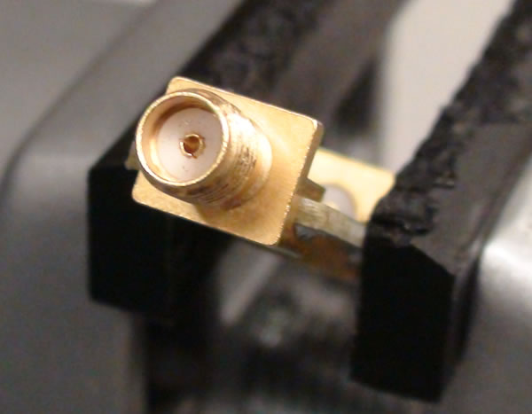
Calibration Process Moves the Reference Plane
Male SMA (plastic dielectric) connector on the end of a cable
Female 3.5 mm (air dielectric) connector on an Open standard
After we calibrate to the end of this SMA test cable, the new calibration reference plane will be coincident with the edge face of this metal ground cylinder which surrounds the center signal pin.
Here is the mating ground surface lip on the female 3.5 mm standard which contacts the metal ground cylinder of the male SMA (like the ends of two pipes touching each other).
Female SMA connector on a board under test
Since this is now the calibration refrence plane...
...when we attach a device to test, the reference plane of zero phase, zero loss, zero mismatch, etc., is this plane here.
Any length of transmission line beyond this plane along this board (in the direction of the blue arrow) will measure as some finite phase delay.

Slide 25
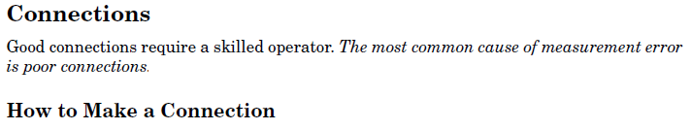
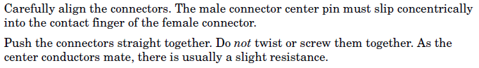
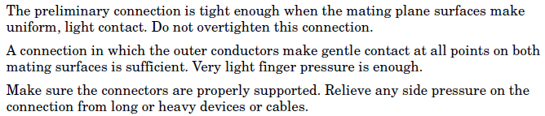
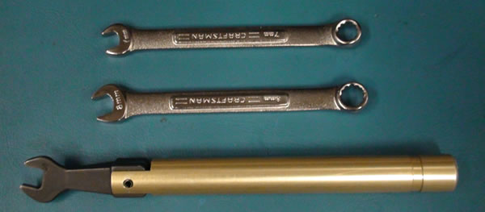
From the 85033E service manual:
http://cp.literature.agilent.com/litweb/pdf/85033-90028.pdf
First, you do a preliminary connection, using just your fingers:
Then you do the final connection:
Open-end 7 mm and 8 mm wrenches
Torque wrench

Slide 26
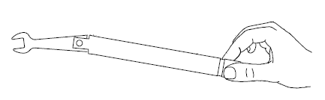
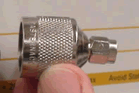
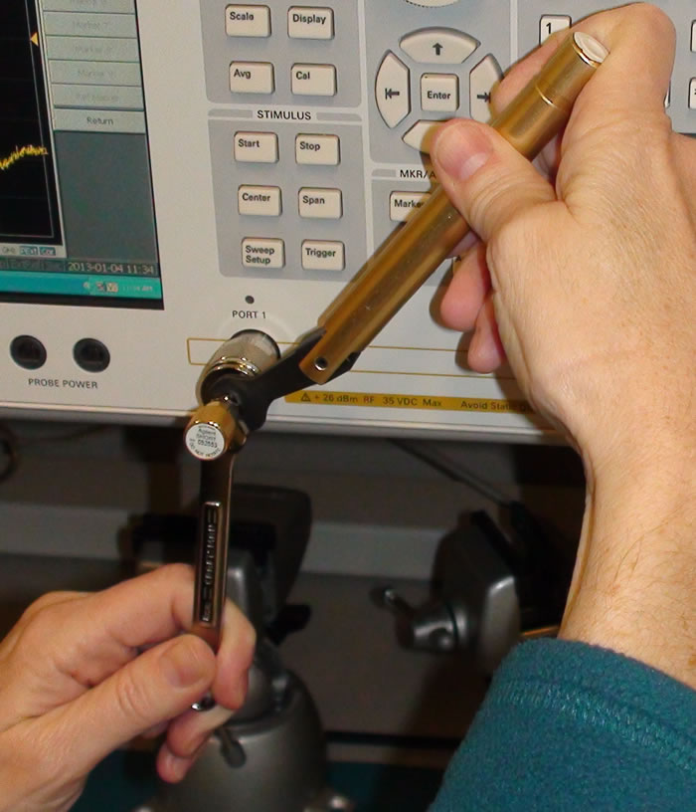
Always hold the torque wrench past these grooves ...
r
F
... because torque is the product of force and distance:
τ = F*r
The calibration standards are all designed to be torqued to 0.9 Nm (which is 8 inch-lbs.)
The torque wrench supplied with the calibration standards is designed to be held behind these grooves. The torque wrench will begin to break at 0.9 Nm, which requires only a small force when held at that distance.
Don’t hold the torque wrench here. Holding the torque wrench at too short of a radius sometimes leads you to accidentally override the ball joint mechanism that creates the breaking at the torque setting.
male-N-to-male-SMA adapter

Slide 27
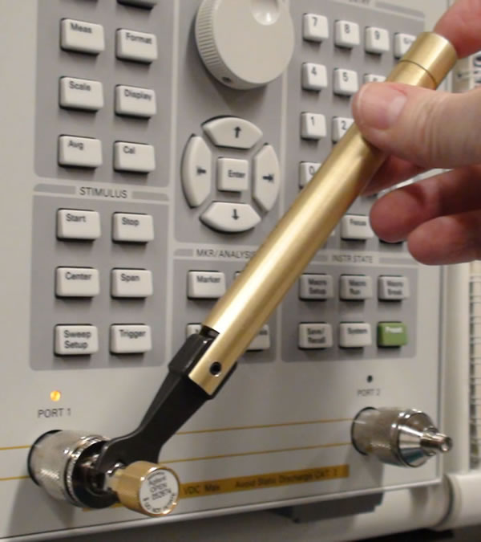
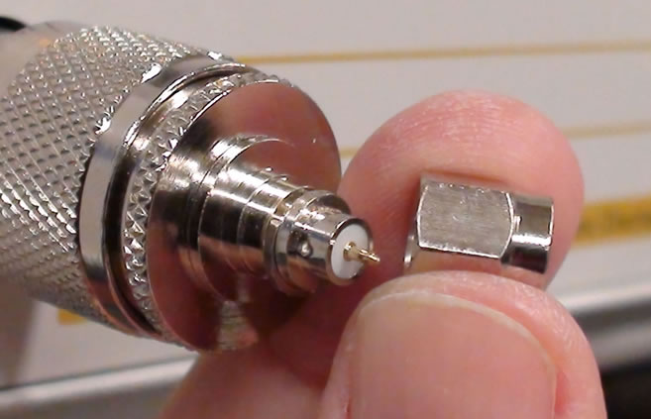
Here’s an example of busting a male-N-to-male-SMA. It was an old adapter I find lying around the lab (might have been slightly bent or damaged). It required quite a bit of torque to tighten the nut, and made a scraping sound. The male nut came off the SMA end of the adapter because the nut was held on by this retaining ring which couldn’t handle the amount of force applied to it when the nut was over-torqued.
wrong
What can go wrong will go wrong.
female standard
male-N-to-male-SMA adapter
male-N-to-female-SMA adapter
Whenever you have one bad connector in your lab, its effects can spread like a virus and ruin all tje cal standards and cables in the lab. This is because the shoulder on each male pin is supposed to be flush with the outer coax ring (or a little negative below it). If its shoulder sticks out positive, it can compress the mating ring of the female cal standard (pic at upper left). Then your cal standard no longer has the offset length it was calibrated at.

Slide 28
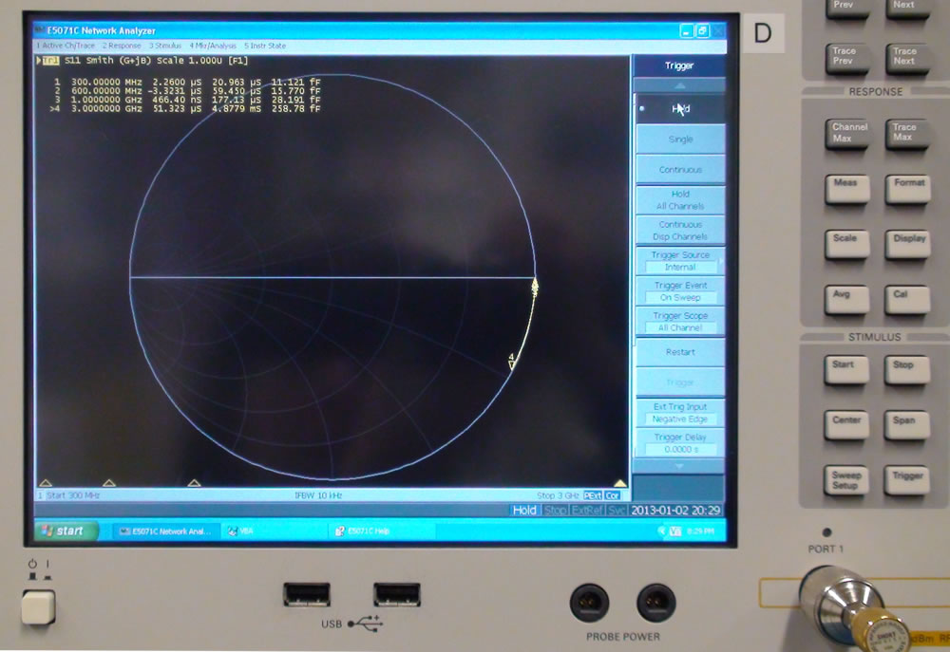
Loose connections can also cause strange effects. You have to tighten all connections with a torque wrench so that connections are made uniformly. For example, this measurement below is so weird. A Short standard is being measured, but the reading says it’s capacitive, like an Open (an arc such as this would be correct if we were actually measuring an Open ... but we’re measuring a Short!) . What’s going on?
If you’re confused as to why an Open should like this arc, see this URL: http://vnahelp.com/tip7.html
male-N-to-male-SMA adapter
It turned out that the adapter had a bent inner cylinder. I thought the standard was hard to screw on, but I ignored it. Don’t ignore that sort of thing. The measurement looks like an Open because the connection wasn’t really connected.
female Short standard

Slide 29
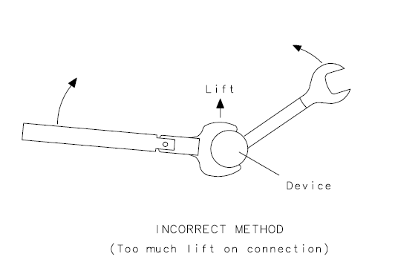
Standards should screw on easily with your fingers. Only the last tiny bit should need the torque wrench.
Don’t insert the torque wrench to a starting position >90º. You won’t be applying a pure torque. This scenario ends up also applying a force in the vertical direction:
Don’t do this:
>90º

Slide 30
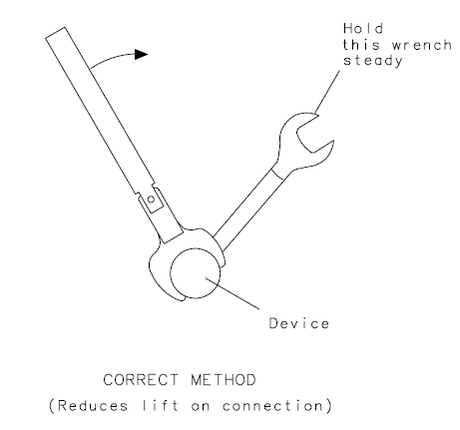
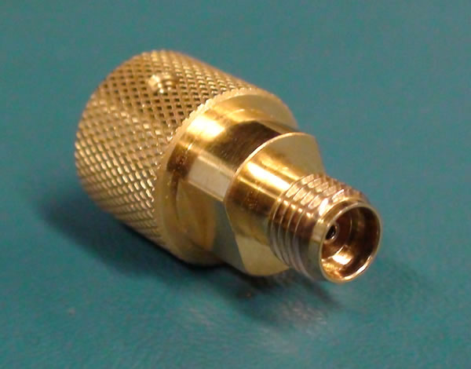

Always use an open-end wrench to hold the standard motionless. Insert the torque wrench on the nut so the starting angle is <90º.
The network analyzer is a precision measurement instrument. All connectors and calibration standards need to be tightened precisely with a torque wrench (to keep the length of internal transmission lines fixed to a precise length). Never over-torque the torque wrench – stop just as it starts to break.
Always use a second open-end wrench to hold the calibration standard. Don’t rotate the standard, rotate the nut. If you rotate the standard, the center signal pin’s gold plating will wear out.
Calibration standards have flats for an 8 mm open-end wrench:
<90º
flat
8 mm open-end wrench

Slide 31




The adapters have flats on both ends for an open-end wrench:
However, you need to use a 7 mm wrench for these adapters. Put the wrench on the flat closest to the end you’re connecting to.
flats

Slide 32




Slide 33





Sometimes you think a connector may be bad, but in this case, it’s just the way it’s made:
Here’s a male Open (85052D standard):
If you just touch the center pin lightly, it moves.
Similarly here’s a female Open (85033E standard):
Its center pin moves too.
Insulator in an Open standard is a little bit flexible. Be careful with these 3.5 mm Open standards.
Be very gentle with these 3.5 mm precision connectors. They’re expensive and easily broken!

Slide 34







Calibration Standards and Their Models in the Agilent Network Analyzers
(from Dunsmore’s book, Chapter 3)
Short Standard
Open Standard
Load Standard
These 50 ohm load elements are thin film resistors which can easily get blown out if you put too much power through them.

Slide 35

Offset Delay of a Short Standard
(from Dunsmore’s book, Chapter 3)
male SMA cable
female Short standard
The Short standard’s actual shorting plane is offset from the mating surfaces to here. The distance between the two planes acts as a length of coaxial transmission line.
Calibration reference plane for zero phase, zero loss, zero impedance mismatch, etc.
35
Offset Delay is the amount of time it takes a wave to travel from the red dotted line to the green dotted line.
Transmission line delay

Slide 36

Offset Delay of an Open Standard
Insulator
Offset Delay is the amount of time it takes a wave to travel from the calibration reference plate (red dotted line) to the plane where the rest is modeled as fringing capacitance (i.e. the plane denoted by the green dotted line).
Calibration reference plane for zero phase, zero loss, zero impedance mismatch, etc.
Transmission line delay

Slide 37


No Offset Delay in a Load Standard
The Load is modeled as a 50 ohm termination resistance, and a characteristic impedance of a transmission line, but with no offset delay (since a wave traveling from the calibration reference plane towards the load will get completely absorbed by the matched Load).
Calibration reference plane for zero phase, zero loss, zero impedance mismatch, etc.

Slide 38


Specifications on the standards in the 85033E calibration kit. This is from the 85033E service manual on this Agilent web page:
http://cp.literature.agilent.com/litweb/pdf/85033-90028.pdf

Slide 39



Agilent sells pin-depth gages for verifying that your 3.5 mm standards are good:
This is the 85052B cal kit, which Agilent sent us as a loaner for two weeks in Jan13. This particular cal kit comes with pin-depth gages for 3.5 mm connectors:
http://cp.literature.agilent.com/litweb/pdf/85052-90077.pdf
One gage measures pin depth for male 3.5 mm connectors, the other measures pin depth for 3.5 mm females.
First, you connect a gage blocks to the gage and then you zero the gage. Then you connect your 3.5 mm standard and see if its pin depth is within spec.

Slide 40

“Pin depth” refers to the distance the center pin is above or below the plane of the end face of the surrounding cylinder:
The calibration reference planes on these 3.5 mm male and female standards are here. These planes are where the ground connection will mate to your corresponding opposite-sex test cable connectors.
This shoulder of the male 3.5 mm connector’s center pin is supposed to be within a specified tolerance distance behind the plane of the end face of the surrounding coax ring (where the red arrows are pointing). The spec is published as a standard and it’s a tighter spec for 3.5 mm connectors than for SMA connectors, which is why 3.5 mm connectors are considered “precision” connectors for test and measurement.
Diagram from Agilent App Note 1287-1 http://cp.literature.agilent.com/litweb/pdf/5989-4840EN.pdf

Slide 41

Close-up of the male 3.5 mm connector:

Slide 42

Close-up of the female 3.5 mm connector:

Slide 43

Agilent gives these instructions for understanding the uncertainty of measurements using one of these gages, so that you can determine if your 3.5 mm cal standards are within spec:

Slide 44
Outline
Intro
First Look at Our Network Analyzers
Calibration Hardware
Cables: Pre-testing Before Calibration
Cal Kit Software in the Network Analyzer
Driving the Network Analyzer
1-Port & 2-Port Cals with 85033E Standards
Port Extension vs. Electrical Delay
Verifying Your Cal is Good: Measuring Something Else
Custom Cal Standards and User Cal Kits

Slide 45
Cables
Quote from Dunsmore book (p. 197):
“Cables are like dogs; either they are bad, they’ve been bad or they are going to be bad, and when they’re good, they only stay good with great care.”

Slide 46

Here’s a cable that measures okay (-1.5 mils). I bought these from L-com for $18, but some test cables that are guaranteed to meet these pin-depth specs, and additionally spec’d to have very low VSWR – can go for $150 - $400.

Slide 47

Agilent tech support says that you need a separate gage kit to measure SMA connectors. They recommended
Maury Microwave (maurymw.com). This is the A027A kit which has 4 gages so that you can measure the depth not
only of the male and female pins, but also the depth of the dielectric.

Slide 48

SMA connector specification:
SMA connectors have much looser specifications than 3.5 mm connectors.
This set of drawings is from MIL-STD 348A which is
the standard for SMA connectors. The tolerance spec
for the pin depth is +0.000”, -0.010”. This means the shoulder can’t stick out at all and it can only be inset less than 10 mils. The gages in the 85052B kit only read to +-0.005” (+- 5 mils).
I bought some Emmerson cables which are so far negative, they don’t even read on the scale of the 85052B gage (but they could be within spec).
Also, all SMA connectors have a dielectric which the 3.5 mm connectors don’t, and so there is a spec in this SMA standard for the tolerance on the distance the dielectric face can be with respect to the reference plane (+0.000”). Actually, you’re supposed to buy special gages for SMA connectors (Maury Microwave sells such gages).
Note that the rubber gasket is actually part of the MIL-STD 348A SMA connector spec.
MIL-STD 348A
(Google it. I found this copy at carlsonmfg.com)

Slide 49

This is a close-up view of an SMA connector that’s more or less made correctly:

Slide 50


Here are some close-up views of really bad SMA cables. These were hand-made in a Cory research lab. There’s a learning curve to crimping such cables and assemblying them correctly.
Notice how far out the shoulder of each center pin protrudes from the end face of the surrounding cylinder.
Throw these cables away. If you screw cal standards into one of these, or attach one to the test port of a network analyzer, and then torque them tight, you’ll ruin the mating connector. The mating connector’s female center receptor will get squashed and won’t be the proper length to make a uniform transmission line.
That means you’ll get reflections, or worse, flaky intermittent problems that are hard to debug.
Always inspect a connector or cable under a stereo microscopre before you attach anything to it.

Slide 51


Good test cables can range from $150 to $400 each. They’re expensive because the dielectric has been melted/flattened so that it doesn’t stick out beyond the mating plane, and because they usually have armor with many layers of jacketing near the ends so they can’t get kinked.
armor
Multiple layers of heat-shrink
jacketing over the armor.

Slide 52


These San-Tron SMA connectors appear to be of high quality.
The center pin’s shoulder is even with the surrounding gold cylinder’s end face (and the pin-depth gage reads -0.0015” (1.5 mils, quite good)). The dielectric is recessed below the mating plane and looks to be machined, as it has machining
marks coaxial with the center pin and surrounding gold cylinder.

Slide 53


If your SMA cables are out of spec (the male pin protrudes in the positive direction), then if you connect your SMA cable to a female 3.5 mm calibration standard, you can ruin the standard. Calibration standards are very expensive, so always check your SMA cables (visually under a microscope and with a pin-depth gage) before attaching to a calibration standard.
Here’s a female calibration standard that’s been destroyed:
Close up
3.5 mm female calibration standards use what are called precision connections for the center receptacle. There are fingers which expand, in order to accept the male pin, but they’re inside a solid cylinder which doesn’t expand. Consequently, the geometry of the electric and magnetic fields to propagate along the air dielectric stays uniform.
This finger has been broken because a male pin’s shoulder which protruded too far hit it and when the two were torqued together it squished the finger down into the hole.
The finger is folder over and smushed down in here.

Slide 54



Pre-testing: Checking Your Cables’ Phase Stability Before Starting a Calibration
Hit the Preset button. Select OK. Displays LogMag S11.
Hook up a cable between Ports 1 & S. Why does LogMag S11 look like this? Because there are always slight impedance mismatches at connections, so we see reflections and re-reflections, albeit 30 dB down.
Hit the Meas key, and choose S21. LogMag S21 looks like this (close to 0 dB) as almost all the signal from Port 1 makes its way to Port 2:

Slide 55




To test our cables, we want to look at the Phase of S21. Hit the Format key and choose phase. The sweep here is up to 4.5 GHz, so phase wraps around about 14 times at that frequency for this particular length of cable.
Hit the Display hard key. Choose:
Data->Memory
Under Dat Math, choose:
Data/Memory
That will make the Phase S21 trace
become zeroed:

Slide 56


Zoom in. Hit the Scale hard key. Set the scale to 1 degree/division:
Now wiggle and bend the cable. The phase changes as you bend or stretch the cable.

Slide 57


Now stop touching the cable. Wait for the trace to settle. Now the phase goes a bit negative by the time the sweep reaches 4.5 GHz. Check how far off the phase is from zero at your frequency of interest.
Once you calibrate, and start moving the cables all around, this different bit of phase each time you change calibration standards and move the cables around during a calibration procedure, is going to get incorporated into the calibration’s error-correction coefficients.
Try it again. Wiggle the cable around some more, then take your hands away and see where it settles. This time we see a bit of positive phase at the upper frequencies.
Expensive cables are usually expensive because they have
good phase stability.

Slide 58
Dunsmore Advice on Pre-Testing Cables
(from the Agilent web forum)
“To test the cable: Place the cable on one port of the VNA, attach a Short or Open standard from a calkit on the other end. Don't cal. J ust do Data->Mem and Data-Mem (that's right, Data -Minus- Memory). Look at the result in dB. Immediately after that, the trace should show -70 or -80 dB return loss. Now flex the cable back and forth and up and down. The trace for a "GOOD" cable should be -50 dB. If the highest spot on the trace is above -30 dB it is a "BAD" cable. Take a wire cutter and immediately cut the cable in 20. For me, I would not use a cable that is worse than -40 dB.”
Let’s do this test on a few cables in our lab...

Slide 59


Cable #12
Just after Data->Mem for each window, and Data-Mem for the top, and Data/Mem for the bottom
Now after wiggling and letting it settle.
This cable is really bad.
LogMag S11
(ref set to -50 dB,
scale set to 10 dB/division)
Phase S11
(ref set to 0 dB,
scale set to 1 deg/division)
Short standard

Slide 60


Cable #2
Just after Data->Mem for each window, and Data-Mem for the top, and Data/Mem for the bottom
Now after wiggling and letting it settle.
This cable is pretty good.
LogMag S11
(ref set to -50 dB,
scale set to 10 dB/division)
Phase S11
(ref set to 0 dB,
scale set to 1 deg/division)
Short standard

Slide 61


Here’s a very good cable (brand new, $50, came with a sheet showing its factory test).
Just after saving into memory, before wiggling:
After wiggling and letting it settle. Below -50 dB for all freqs up to 4.5 GHz. Good.

Slide 62
When are “bad” cables okay to use? When do you need to re-calibrate?
Cables are really bad if the male pin’s shoulder sticks out beyond the reference plane, since that can
damage cal standards or test port savers. Don’t use those.
Other cable problems can be calibrated out to some extent. That is, as long as the trace is stable, then any mismatch, phase delay and loss can be calibrated out. But if they cables aren’t stable, they’ve probably been crimped or cracked and have intermittent connections.
When you’ve achieved a “good” calibration, it can last for a week or two because the network analyzer itself is a fairly precise instrument, but we often change our setups so this is moot.
Re-calibration should be done if you dis-connect and re-connect cables, or if you change the frequency sweep settings such that the sweep is over a larger range than when calibration was done.
Calibration does not have to be re-done however, when simply changing the output power level of the analyzer (e.g. for amplifier measurements). Older analyzers used to require re-calibration after a power level change, but our E5071Cs don’t need to be re-calibrated after changing the power level.
Final caveat: if you’re in a room with air conditioners turning on and off, very precise measurements can sometimes detect that temperature change.

Slide 63
Outline
Intro
First Look at Our Network Analyzers
Cables: Pre-testing Before Calibration
Calibration Hardware
Cal Kit Software in the Network Analyzer
Driving the Network Analyzer
1-Port & 2-Port Cals with 85033E Standards
Port Extension vs. Electrical Delay
Verifying Your Cal is Good: Measuring Something Else
Custom Cal Standards and User Cal Kits

Slide 64
Cal Kit Sofware in the Network Analyzer
Transferring a Software Cal Kit from One Network Analyzer to Another

Slide 65
When Joel visited, he realized we had been using incorrect cal kits on the analyzers all semester. A cal kit is a set of parameters stored in the analyzer that you select to match the hardware calibration standards you’ll be using. The 85033E cal kit we had been using with the 85033E calibration standards was incorrect because no parameters were defined for the Thru standard.
Joel fixed this. He characterized our Thru standard by measuring its delay. Then he input that Offset Delay parameter into a new cal kit he created, which he named 85033E_thru. That cal kit was stored on the one network analyzer he was working on (the 4-port 8.5 GHz analyzer).
These next few slides illustrate how to export that cal kit file and transfer it to the other analyzers in the lab. These slides also show some of the menus on the analyzer for dealing with cal kits.
* One month later, we found another error in the 85033E cal kit. Basically, the 85033E cal kit should have the same parameters as the 85052D cal kit. However, the 85033E cal kit’s number for the Short’s offset delay was incorrectly set to 31.088 ps, instead of 31.785 ps.

Slide 66



Thru Standards Aren’t Normally Defined in a Factory Cal Kit
From Dunsmore’s book, Chapter 3:
Read this
This is the bug Joel Dunsmore found on his visit of 11/30/12. He modified our 85033E cal kit to account for the 95 ps delay of this female-to-female Thru. The new cal kit, which you should use, is named 85033E_thru.
Example Cal Kit
(from Dunsmore’s book, Chapter 9)
Equivalent to ohms/ns, which for each freq in the sweep is equivalent to ohms/length of the transmission line.

Slide 67

Soft-key menu title bar
“E5071C Menu” is the top-level menu.
Touch the “Calibrate” soft key to go to the Calibration menu (or press the Cal hard key). We want to export the (software) cal kit that we modified yesterday that goes with the 85033E calibration standards.

Slide 68

Soft-key menu title bar tells us we’re now in the Calibration menu
The default cal kit is not what we want, so touch here to change it.

Slide 69


We’re now in the Cal Kit menu.
We want 85033E_thru. Touch here.
Brings us back to the Cal menu
This is what we want. We want to export it.
So now select Modify Cal Kit.

Slide 70


We’re in the Modify Cal Kit menu.
These two buttons are for changing the parameters in the cal kit. “Define STDs” takes you to a menu that lets you re-define a standard (i.e. your short, open, load or thru). “Specify CLSs” takes you to a menu that lets you specify the various classes for your standards. Joel Dunsmore did this yesterday during his visit when he modified this cal kit. Right now, we just want to export the 85033E_thru cal kit and copy it to the other network analyzers in the lab.
Click here on Export Cal Kit.
The network analyzer is running Windows XP and it pops up a dialog that lets you save the cal kit file to a thumb drive as a .ckx file. You can get to Windows at any time by clicking on the Windows Start button at the lower left of the screen. You can plug any USB or PS2 keyboard/mouse into the back of the network analyzer to type entries.

Slide 71

You can open the exported cal kit file in a text editor in Windows on the network analyzer. The cal kit is stored in ROM internally in the network analyzer in some format, but when it exports it, it formats the calibration information in XML . You can read more about the contents of the file in Joel Dunsmore’s book: Handbook of Microwave Component Measurements (available at the UCB library site as an ebook).
Also, if you want to change a cal kit definition, say for your own printed circuit board cal kit that you design, and you don’t want to mess with the button interface on the network analyzer, you can change this file in its XML format and then import it back in and give it a new name.
We’re just going to take the thumb drive to another network analyzer work and import it there.

Slide 72


Now back to this 2-port network analyzer. Select the Calibrate soft key (or the Cal hard key) to go to the Calibrate menu.
This analyzer’s default cal kit happens to be the old “85033E”.
Select Modify Cal Kit.

Slide 73



Select Import Cal Kit.
Then navigate to the “85033E_thru” cal kit you stored on your thumb drive, and click OK.
Now the default under Label Kit is “85033E_thru”
Hit Return to pop back to the Calibrate menu. Our current cal kit is now 85033E_thru.

Slide 74



This is the new 85033E_thru cal kit (XML format). The arrows point to things that we added or fixed. Check that the analyzer you’re using has these updates.
Short: L = 2.0765e-12 - 1.0854e-22*f + 2.1705e-33*f² - 1e-44*f³ Henries
Z = 50 Ω real
Offset delay = 31.785 ps
Insertion loss = 2.36 GΩ/s
Open: C = 4.943e-14 - 3.1013e-25*f + 2.317e-35*f² – 1.6e-46*f³ Farads
Z = 50 Ω real
Offset delay = 29.243 ps
Insertion loss = 2.2 GΩ/s
Load: C = L = Offset delay = Insertion loss = 0
Z = 50 Ω real
F-F Thru: C = L = 0
Insertion loss = 2.2 GΩ/s
Z = 50 Ω rea
Offset delay = 95 ps
Chage to 2.51 Gohm/s

Slide 75

Agilent does have these cal kits on line. Here is the web site for the 85033D/E.
http://na.tm.agilent.com/pna/caldefs/PNA/85033DE.htm

Slide 76



The 85052D cal kit looks like this after exporting and then opening it in a text editor:
Short: L = 2.0765e-12 - 1.0854e-22*f + 2.1705e-33*f² - 1e-44*f³ Henries
Z = 50 Ω real
Offset delay = 31.785 ps
Insertion loss = 2.36 GΩ/s
Open: C = 4.9433e-14 - 3.10131e-25*f + 2.31682e-35*f² – 1.5966e-46*f³ Farads
Z = 50 Ω real
Offset delay = 29.243 ps
Insertion loss = 2.2 GΩ/s
Load: C = L = Offset delay = Insertion loss = 0
Z = 50 Ω real
Thru: C = L = Offset delay = Insertion loss = 0
Z = 50 Ω real

Slide 77

This is the Agilent web site for the 85052D cal kit.
http://na.tm.agilent.com/pna/caldefs/PNA/85052D.htm

Slide 78
The fact that the value in the 85033E Short’s offset delay was 31.088 ps, instead of 31.785 ps, means its calibration kit thought the standard was shorter by ~0.7 ps than it really is (or 1.4 ps for a there-and-back-again delay mismeasurement.
A Short standard is modeled by its offset delay and some inductance. At 50 ohms impedance (where our inductors have most of their effect in, say, a 50 ohm matched filter) that 1.4 ps of mistake corresponds to the inductance measurement being off by:
1.4 ps * 50 ohms = 70 pH

Slide 79





Update the cal kit via these menus:
Then export the cal kit and check it in a text editor to make sure the information got updated.
Change to 31.785 ps with the keypad

Slide 80



Looks good. Both changes are in the file. We have a f-f thru with a delay of 95 ps and the Short has a delay of 31.785 ps.

Slide 81
Outline
Intro
First Look at Our Network Analyzers
Cables: Pre-testing Before Calibration
Calibration Hardware
Cal Kit Software in the Network Analyzer
Driving the Network Analyzer
1-Port & 2-Port Cals with 85033E Standards
Port Extension vs. Electrical Delay
Verifying Your Cal is Good: Measuring Something Else
Custom Cal Standards and User Cal Kits

Slide 82
Driving the Network Analyzer
Setting up for Doing a Calibration

Slide 83


The first things to understand about driving the network analyzer are the concepts of channels vs traces ... and how those two things related to display windows on your screen.
After executing a Pretest + OK, the analyzer screen should come up like this (LogMag S11 flat at 0 dB):
Hit the Display hard key to bring up the Display menu. The first 3 selections deal with channels and traces. Traces are subsets of channels. Different channels can be calibrated with different sweep setups. Select the Allocate Channels soft key.

Slide 84


You can see from the Allocate Channels menu, that the Preset gave a default state of 1 channel:
Now select here: 2 channels stacked vertically.
Notice these channel bars are labeled 1 & 2. Also noticed that each has labels for Start, Stop and IF freqs so that you can set up the frequency sweep for each chanel differently.
Also note that each channel’s error-correction icon presently says “Off”. Neither channel has been calibrated yet.

Slide 85



Normally, we just want to use 1 channel (we want a single calibration to serve for all of our traces). Set Allocate Channels back to 1 channel:
Hit the Display hard key. Select “Num of Traces”. The Preset trace made the default number of traces be 1:
Select 2:

Slide 86

Always watch this upper left area for Trace info. We now have 2 traces (which are measuring the same thing) in a single display window. Both traces are displaying LogMag S11. Tr1 is yellow, Tr2 is blue, but Tr1 is the active trace. The active trace has its trace-number’s background highlighted and has an arrow to its left.

Slide 87


Next, put the 2 traces into separate display windows. Hit the Display hard key to bring up the Display menu. Select the Allocate Traces item to set up the allocation of traces to display windows (select the icon for two windows stacked vertically):
When we allocated 2 channels previously, we had 2 channel bars with separate frequency setups. Here we have 1 channel, with 2 traces in 2 separate windows. If we do a calibration now, the error-correction will apply to the traces in both of these windows.

Slide 88

Notice the hard keys at the right for Trace Prev, Trace Next & Trace Max. Hit the Trace Next key.
Tr2 becomes the active trace:

Slide 89


The Trace Max hard key toggles to maximize the window that has the current trace (i.e. make it use the entire screen).
Tr1 & Tr2 are still measuring the same thing. Hit the Meas hard key to change what the active trace should measure:

Slide 90

Select S21 to change Tr2 to measure LogMag S21. Hit the Scale hard key to rescale the Tr2 (active) window:

Slide 91


Select Reference Value and use the keypad to enter “-50”. Then hit the “x1” (for times one) hard key. The field knows to add the units of dB because the trace format is LogMag.
Ref value marked by arrow
Hit the Entry Off hard key to make the Entry field disappear.

Slide 92


Hit Trace Next to make Tr1 active. Hit the Format key and select Phase to view the phase of S11 in the top window:
The Trigger hard key lets you choose between continuous triggering (Meas) vs. stopping the trigger (Hold).

Slide 93


Before calibration, set the sweep parameters ro Start at 300 MHz and Stop at 3 GHz:
Use the suffix keys at the far right to choose MHz vs. GHz

Slide 94
Select the Avg hard key to set the IF bandwidth. Higher
IF frequency updates the sweep more quickly, but adds noise. 10 kHz is good.

Slide 95


Hit the Sweep Setup hard key. Leave Sweep Mode set to stepped (most accurate). Leave Sweep Type set to Linear. Maximize the number of sample points per sweep (1601).
0 dBm (1 mW) is fine for testing passive circuits. When testing amplifiers, make sure not to put too much power into the analyzer (i.e. from the output of your amplifier into Port 2 when measuring S21).
26 dBm is the max power the analyzer can handle.

Slide 96


To save all S-parameter data to a file which you can later import into ADS, SpectreRF, Microwave Office or Matlab’s RF toolbox, press the Save/Recall hard key.
Save State – saves your setup configuration and calibration correction coefficients to ROM. Use File Dialog and save out to your own thumb drive.
Save Trace Data writes out a .csv (comma separated variables) file for importing into Excel.
Save SnP (“n” is the number of ports, usually 2). This will write out a .s2p file.

Slide 97

The System hard key provides miscellaneous functions like grabbing a screenshot (.bmp or .png formats).
Dump Screen Image
The Marker hard key lets you set markers. Marker Fctn lets you turn on Marker Statistics.

Slide 98

We haven’t calibrated yet, but let’s measure an Open standard. Make the bottom window’s trace active and set it to measure LogMag S11. Hit the Trace Next hard key. Hit the Format hard key. Set the top trace to Smith Chart, G+jB format. Turn markers on and set up 4 markers at different frequencies. Note the yellow Tr1 info line:
This scale of 1.000u means “one unit” ... i.e. the Smith Chart is set to a unit circle of radius 1.
Male Open std

Slide 99


The analyzer display is a touchscreen:
Tap once to make a trace the active trace. Here we’ve tapped once and the active trace switched from being the upper window to the lower window.
In addition to the single tap, the analyzer also responds to a double tap. The double tap executes the Trace Max hard key (maximizes the window). It doesn’t always work though. Try double-tapping on a screen that has two trace windows. Sometimes it will maximize, but not always.

Slide 100
Outline
Intro
First Look at Our Network Analyzers
Cables: Pre-testing Before Calibration
Calibration Hardware
Cal Kit Software in the Network Analyzer
Driving the Network Analyzer
1-Port & 2-Port Cals with 85033E Standards
Port Extension vs. Electrical Delay
Verifying Your Cal is Good: Measuring Something Else
Custom Cal Standards and User Cal Kits

Slide 101

1-Port & 2-Port Cals with 85033E Standards

Slide 102
The way the one-port calibration works is this:
...you’re trying to find out 3 terms which represent the port/cable characteristics.
After you do the calibration, the network analyzer comes up with correction coefficients which it uses to correct any subsequent measurements. All of the network analyzer’s errors will then be exactly calibrated out at 3 impedances: the impedances of the Short, Open and Load standard you just applied during the calibration (whose pre-measured model values were stored in their software cal kit on the analyzer). There will be small residual errors at all other impedances you try to measure.
To verify that you have a good calibration, you need to measure something other than the 3 standards you just used to do the calibration, because if one of those standards was bad, it will take whatever it measured and call it the value which was defined in the cal kit. Consequently, if you measure that bad standard again, it will simply tell you the model value stored in the cal kit. It can’t know that it was bad. It assumes that you put on a good one. That’s why you need to measures a fourth standard, say a Short or an Open, from another kit, whose model value (primarily a delay) you can look up.
If your network analyzer reports a measurement of this 4th standard that is consistent with that standard’s cal kit model, then you know you have a good cal.

Slide 103





First, we’ll do a 1-Port cal. Calibrate Port 1 using 85033E female standards.
The Open, Short & Load standards can be put on in any order. We’ll start with the Open. Use the 8 mm open-end wrench and a torque wrench to attach it to Port 1. Hit the Calibrate hard key. On the Calibration menu which appears, select Calibrate. Then follow these menus (make sure you select the 85033E_thru cal kit):
male-N-to-male-SMA adapter
male-N-to-female-SMA adapter
Sweep setup is still: Linear sweep from 300 MHz to 3 GHz, IF=10 kHz, 1601 pts.
The analyzer takes the measurement and then puts a check mark next to the Open selection.
85033-60019 female Open

Slide 104



Repeat with the 85033E Short & Load standards
After you hit Done, this [F1] flag should appear, signifying that the analyzer is now applying full 1-port error correction.
85033-60021 female Short
902-60004 female Load
Then make sure to hit Done (and not Return).
When you hit Done, the analyzer does calculations on
The 3 measurements of the Open/Short/Load and determines the error-correction coefficients to be applied on subsequent measurements. Then it sets this “Cor” flag to have a bright blue background.

Slide 105

Because the Load is still attached, the measurement of the lower trace, LogMag S11, is more negative than the window displays. Hit the Scale hard key. In the Scale menu which appears, set the Reference Value to -50 dB and set the Scale/Div to 10 dB/div. Because this measurement is a measurement of a standard which we just used in the calibration, this measurement doesn’t tell us much. By definition, all errors cancel at the 3 impedances of the measured standards. That is, the return loss is not really -80 dB (it’s typically more like -50 dB when we measure a typical Load). Also, notice the upper trace has the Smith Chart set to admittance format. (You can tell because the real & imaginary parts are given in units of mS and uS. Switch the Format to impedance Smith Chart.)

Slide 106

Now the real & imaginary parts are given in units of ohms.
... And this real part is obviously way too perfect across all frequencies.

Slide 107


We need to measure something else. We have another Load standard, this 902-60003 male Load. We’ll need to connect a female-female adapter to the just-calibrated Port 1
The impedance Smith Chart shows a little bit of impedance real part variation across frequency:
The return loss is really on the order of -50 dB:

Slide 108

Zoom in on the Smith Chart by scaling the radius to 0.1. Now you can see that a real Load measurement is not a perfect dot.
Again, the proper way to verify if a calibration is good is always to measure something else. If that something else is a calibration standard, then you can see if its measurements match its model (but the standard you measure, has to not be one of the 3 you calibrated with). We’ll verify an ECal calibration with this technique, later on in these slides.

Slide 109





Now, we’ll demonstrate a 2-Port cal. Calibrate Ports 1 & 2 using 85033E female standards.
Hit Preset.
Sweep setup: 300 MHz to 3 GHz, IF=10 kHz, 1601 pts.
Attach male-male SMA cables to each of Ports 1 & 2.
Start with male-N-to-female-SMA adapters on both ports.
Attach a 85033E female Open to the end of the cable attached to Port 1 (use the 8 mm open-end wrench and the torque wrench). Hit the Cal hard key. Select the 85033E_thru cal kit.
On the Calibration menu, select Calibrate. Then select 2-Port Cal:
Repeat for Short & Load

Slide 110





Repeat again on Port 2:
Attach the 85033E thru adapter (use the 7 mm open-end wrench and the torque wrench).

Slide 111




Since we haven’t calibrate yet, the LogMag S11 and LogMag S22 traces will look all ripply.
After setting up your traces, they way you want them, hit the Cal hard key again and resume the cal. You already finished the Reflection (one-port) measurements. Now select Transmission again. You can resume the calibration from where you left off when you changed your windows/traces.
Select f-f thru to execute the transmission measurements.
Check mark appears. Hit Return. You still haven’t calibrated!
Skip Isolation. Hit Done. Now you’re calibrated. The analyzer takes all the measurements (in whatever order they were done) and does its computations.
Note this “Cor” icon still says Off.

Slide 112

Now we’re calibrated. The analyzer reset the display this way (I don’t know why).
More importantly, notice 2 things to see that error-correction is now being applied. First, [F2] appears at the end of this trace info line, signifying that a full 2-port error-correction calibration is now in effect.
Also, this flag now says “Cor” and its background is bright blue.

Slide 113

We still have the female-female thru adapter connected which we calibrated with. If we reset the display so as to display LogMag S21 and Phase S21, we can see that the traces are perfect ... too perfect. We really need to measure something else, to see the residual systematic errors of our calibration. This is just showing random (trace noise) error.

Slide 114



We need to measure something else. Here we’ve attached a female Short standard to the end of the Port 2 cable.
If we look at the magnitude and phase of S22, we see something like this. We’ll go over characterizing standards such as this one, more precisely, later in these slides. Next though, we’ll look at understanding the difference between two features on the network analyzer: Port Extension & Electrical Delay
Setting the top trace display S22 on an admittance Smith Chart. This is the correct type of trace for a Short standard. It has some phase due to its offset and due to a small amount of inductance.

Slide 115
Outline
Intro
First Look at Our Network Analyzers
Cables: Pre-testing Before Calibration
Calibration Hardware
Cal Kit Software in the Network Analyzer
Driving the Network Analyzer
1-Port & 2-Port Cals with 85033E Standards
Port Extension vs. Electrical Delay
Verifying Your Cal is Good: Measuring Something Else
Custom Cal Standards and User Cal Kits

Slide 116

Port Extension vs. Electical Delay

Slide 117
With the calibration already done as in the previous slides, let’s hook up this Open board (also used for mounting series components) to the Port 2 cable. The full 2-port calibration had moved the reference planes to the ends of the cables. We can use the reflection of the Open at the end of the transmission line on the board to demonstrate how the Port Extension and Electrical Delay features work.
Cable attached to Port 2
Calibration reference plane (reference for zero phase, zero loss, zero mismatch)
Location of the open

Slide 118


Look at S22 on an admittance Smith Chart. The Smith Chart in G+jB mode shows a capacitive trace for the Open board. A perfect Open would be a dot on a Smith Chart (or a flat line of 0º over all frequencies on a Phase chart), but there is no such thing as a perfect Open. There will always be some fringing capacitance, and in this case there is also some phase accrual due to the length of the transmission line which extends from the calibration reference plane up to the Open. If we’d like to separate out the fringing capacitance separately separately from the delay of the transmission line, we can add Electrical Delay.
Touch here to make this trace active. Electrical Delay only works on the active trace. Even though both windows are displaying S22, Electrical Delay will only affect this window.
Electrical Delay is found after hitting the Scale hard key (Port Extension is under the Cal hard key). With Tr2 active, key in 100 ps of Electrical Delay. Notice that only Tr2 changes. Electrical Delays of different amounts can be added to individual traces, even if they are both measuring, say, S22.
Note the Tr2 info line. It now says “Del” signifying that Electrical Delay is on.

Slide 119


Add more Electrical Delay to Tr2 until the Phase trace is flat at 0º for all frequencies. Here, we’ve put in 240 ps of Electrical Delay, and we’ve scaled to 45º/div.
We need to add about 250 ps of Electrical Delay to have the phase be closest to 0º across all frequencies.

Slide 120


Now make the top window be the active trace and add the same 250 ps of Electrical Delay. The trace is capacitive with some bit of loss. Notice the Tr1’s info line now says “Del”.
Turning on markers, we can see how the capacitance changes with frequency. We could fit these markers’ capacitances to a curve to create a model of this Open’s fringing capacitance (and we could use the Electrical Delay to provide the info needed to model the length of the transmission line).

Slide 121

Make Tr2 active, set its format to LogMag and scale down to zoom in. We can see that there is attenuation with frequency. We could use this information to get at the info needed to model the transmission line as a lossy line.
Now let’s redo these steps using Port Extension. Set both traces back to having zero Electrical Delay. Set Tr2’s format back to Phase.

Slide 122





With Electrical Delays off, we see this (here, we’ve just selected “Expand Phase” on the Format menu. That unwraps the phase.
Now turn on Port Extension on Port 2:
Enter 100 ps
Notice that both traces change:
Port Extension always applies per port, not per trace.
This PExt flag appears and its background turns bright blue.

Slide 123

We need to add about 128 ps of Port Extension to make the phase as flat as possible at zero, without the phase going positive (thus the remaining phase shift can be modeled as capacitance).
Port Extension reports half the value that Electrical Delay reported (250 ps) for this S22 measurement. Port Extenstion reports half for reflection-type measurements and the same as Electrical Delay for transmission-type (S12 or S21) measurements. In this way, Port Extension acts to move the reference plane (the plane of zero phase) of the entire port by a certain delay or length. Port Extension also has a feature to account for loss, so that the reference plane for both zero phase and zero loss can be moved. What Port Extension cannot account for is any possible mismatch. That’s why you need to do a real calibration to the ends of the cable tips. If your device under test doesn’t have the connectors that match your cables, you can use Port Extension to move the reference plane right up to the device (albeit, without accounting for possible mismatch).

Slide 124

Our E5071C network analyzers have a new feature (~2005), called Automatic Port Extension (APE). APE algortithms decide for you how much delay there is to a reflecting surface (i.e. an open or short). The APE algorithms can also model the loss of the transmission line up to where it will set the new reference plane. Sometimes in doing this however, the algorithm can over-compensate such that it effectively introduces mismatch (which will make attenuation look like gain and mess up any simulations you do later with this data). Consquently, there is a selection with the APE for “mismatch adjustment”. A detailed description of the APE algorithms is given in Dunsmore’s book, Chapter 9:
From Dunsmore’s book, p. 581.

Slide 125






Turn off Port Extension, and let’s re-do the previous measuement using APE:

Slide 126




The APE then algorithms run and set the traces this way:
Hit Return.
Then go look for what values it determined.
It came up with 138 ps (as opposed to our 128 ps). Now look to see what it came up with for its loss model.
The Automatic Port Extension uses these values for offset delay and loss to move the reference plane up to the edge of the Open (where presumably you could solder in a series component).

Slide 127
Outline
Intro
First Look at Our Network Analyzers
Cables: Pre-testing Before Calibration
Calibration Hardware
Cal Kit Software in the Network Analyzer
Driving the Network Analyzer
1-Port & 2-Port Cals with 85033E Standards
Port Extension vs. Electrical Delay
Verifying Your Cal is Good: Measuring Something Else
Custom Cal Standards and User Cal Kits

Slide 128
Verifying Your Cal: Measuring Something Else
Verifying 10 Standards after a 1-Port ECal
85033-60019 female Open standard
85033-60021 female Short standard
85052-60007 female Short standard
902-60004 female Load standard
85033-60018 male Open standard
85033-60020 male Short standard
85033-60016 male Load standard
85052-60008 male Open standard
85052-60006 male Short standard
902-60003 male Load standard
This next section of slides catalogs what these 10 standards are supposed to look like on the analyzer when their measurements are good. We’ve assembled this catalog of correct measurements so that we can refer to it in the future if we suspect problems.
*We own 2 more mechanical cal standards, an Open and a Load, but they are presently out being repaired.

Slide 129

Note that Agilent provides a downloadableUncertainty Calculator to allow you to determine if the residual errors measured after calibration are within the uncertainty specs:
http://www.agilent.com/find/na_calculator

Slide 130






We add a male-N-to-male-SMA adapter.
The analyzer’s test port is a female N connector.
Setup:
Linear sweep, 1601 pts,
300 MHz – 3 GHz, IF = 10 kHz
Attach the ECal to Port 1 and execute a full 1-port cal on Port 1 as shown here:
If you don’t press these soft keys exactly correctly, an error will appear at the bottom left of the screen “ECal module not in appropriate RF path”. It’s possible the ECal is broken, but first check that you’ve selected the correct sequence of soft keys. Your selection has to match how you’ve connected the ECal to the analyzer. For instance, if you don’t have both of Ports A & B of the ECal attached to Ports 1 & 2 of the analyzer and you select “2-Port Cal” on the ECal menu, then of course you will get that error. Similarly, if you have just one of Ports A or B connected, say to Port 2 of your analyzer, and you select Port 1 on the 1-Port Cal menu, of course you will also get that error.

Slide 131




After calibration, the calibration reference plane for zero phase, zero loss, zero mismatch is the end face of this ground cylinder of this male-N-to-male-SMA adapter attached to Port 1 (that we connected the ECal to).
We have these 4 female and 6 male standards which we can measure to verify our cal, or more importantly, verify that these cal standards really are what their cal kit says they are.
Female 85033E Open & Short standards
Female 85052D Short std
Female 902D Load std
85033-60019
85033-60021
85052-60007
902-60004
After measuring the 4 female standards, we’ll add a female-female adapter and then measure these 6 male standards. The calibration reference plane remains at the same location.

Slide 132
Note: caveat on low-frequency measurements when calibrating with an ECal
We have to be very careful when using low frequencies to extract model results. The effects of the capacitances at low frequencies is very small, and even the slightest error in calibration such as can happen with a non-perfect load or even ECal (an ECal as a load provides only a 50 dB effective impedance match). Such a slight error in calibration can cause a very slight phase variation. At low frequencies, a slight phase variation can swamp the values of the measured capacitances. It’s best to do the comparisons of measurements/models at frequencies no lower than perhaps 300 MHz, and use the range up to 3 GHz to verify the models. If you compute the effective delta-match from the capacitance model at low frequency you will find it falls well below 0.003 which is on the order of -50 dB.
This is why, when we set up the sweep for the ECal we just ran, we set the sweep from 300 MHz to 3 GHz.

Slide 133



After the ECal finishes the calibration, it leaves the LogMag S11 trace in an arbitrary position, depending upon what state the internal switches were left in.
On the ECal menu, select Confidence Check. The trace moves back to 0 dB. Press the Help key to find out more about Confidence Check.

Slide 134


1. Verifying the 85033-60019 Female Open Standard
Open: C = 4.943e-14 - 3.1013e-25*f + 2.317e-35*f² – 1.6e-46*f³ Farads
Z = 50 Ω real
Offset delay = 29.243 ps
Insertion loss = 2.2 GΩ/s
85033-60019 Female Open
LogMag S11 at 0.02 dB/division. It’s a small amount above 0 dB,
but that is just residual error (calibration isn’t absolutely perfect).
Looks good.
Admittance Smith Chart. Values are capacitive, but we haven’t accounted for the offset delay yet:

Slide 135



85033-60019 Female Open
Dial in a port extension value for Port 1 of 29.243 ps:
Make sure it doesn’t say “Del” here. We’re turning on Port Extension only (no Electrical Delay should be on). F1 means a full 1-port cal is in effect.
An Open standard has a small amount of capacitance.
Make sure this icon for Port Extension has appeared. It has a blue background signifying Port Extension is in effect. Also, the Cor icon should be on, signfying that error correction (full 1-port cal) is happening on all measurements.

Slide 136

85033-60019 Female Open
Read off the capacitance values:
300 MHz: 41.468 fF
600 MHz: 40.367 fF
1 GHz: 39.983 fF
3 GHz: 47.453 fF
Set 4 markers: 300 MHz, 600 MHz, 1 GHz, 3 GHz.
Re{Y11}
Im{Y11}
Im{Y11} / omega

Slide 137

85033-60019 Female Open
The measurements are 39-47 fF and the model says 49 fF. Looks good.
+ markers are the measured values
85033E Open: C = 4.943e-14 - 3.1013e-25*f + 2.317e-35*f² – 1.6e-46*f³ Farads

Slide 138


85033-60019 Female Open
We can also read off the values of the phase of S11:
300 MHz: -0.44785 degs
600 MHz: -0.87191 degs
1 GHz: -1.4393 degs
3 GHz: -5.1215 degs
Similarly, we can see the LogMag S11 values:
300 MHz: -0.0023 dB
600 MHz: 0.0023 dB
1 GHz: 0.0009 dB
3 GHz: -0.0149 dB
Next, we’ll measure another standard. Turn Port Extension back to zero and turn it off (good habit before the next measurement).

Slide 139


2. Verifying the 85033-60021 Female Short Standard
Short: L = 2.0765e-12 - 1.0854e-22*f + 2.1705e-33*f² - 1e-44*f³ Henries
Z = 50 Ω real
Offset delay = 31.785 ps
Insertion loss = 2.36 GΩ/s
Port Extension is off here. It only
adds phase, so it doesn’t affect the LogMag S11 plot (unless you’ve turned on the advanced feature of loss compensation inside the Port Extension menu settings).
The Smith Chart displays complex values and so effectively tells us about the phase of the measurement. Because the offset delay is specified in the model as 31.785 ps, we turn on Port Extension here and set it to 31.785 ps. The trace is not exactly a perfect dot because the model also has some inductance, which accrues some slight phase.
85033-60021 Female Short
LogMag S11 at 0.02 dB/division. Looks good.
Check that the icons for PExt and Cor are on. The Meas icon signifies that the analyzer is continuously triggering When it changes to Hold, it signifies that I put triggering on Hold in order to capture a clear screenshot of marker values.

Slide 140

85033-60021 Female Short
Now, turn on the markers to read off the inductance values.
300 MHz: 34.433 pH
600 MHz: 12.529 pH
1 GHz: 14.422 pH
3 GHz: 4.7583 pH

Slide 141

85033-60021 Female Short
The model calls out about 2 pH, but my measurements range from 4 – 34 pH.
+ markers are the measured values
85033E Short: L = 2.0765e-12 - 1.0854e-22*f + 2.1705e-33*f² - 1e-44*f³ Henries

Slide 142


85033-60021 Female Short
We can also read off the values for the phase of S11. A Short’s phase starts at 180 degs. Here, in order to scale it better, I subtracted off 180 degs. Reading off the phase values:
300 MHz: -0.057504 degs
600 MHz: -0.081043 degs
1 GHz: -0.18013 degs
3 GHz: -0.20106 degs
Of course, you need to add back 180 degs to get the true phase.
We can also read off the LogMag S11 values:
300 MHz: -0.0110 dB
600 MHz: -0.0070 dB
1 GHz: -0.0107 dB
3 GHz: -0.0046 dB
Turn Port Extension back to zero and turn it off before the next measurement. Also turn Phase Offset back to zero.

Slide 143
Joel’s explanation for why the measurements of the Shorts seem so far from their models:
The phase of the inductive offset should be on the order of 0.05 deg at 3 GHz. If I read it correctly, an inductance of 20 pH gives a phase of 0.14 deg at 3 GHz. The ECal calibration quality is on the order of 0.3 degrees accuracy. So your frequency is still much too low to discern the value of inductance errors within the calibration quality of the ECal. Note, that for the Short, 2 pH inductance is still very very very tiny and even at 30 GHz (max for this connector), it only gives an additional 0.3 deg shift. So, to get better results for your effort (which is to quantify the calibration kits), you cannot use the current quality of calibration that you have. In fact, you probably would have to go to a high quality calibration lab such as ours to even get close. AND...the kits (Shorts) can vary by about +-0.25 degrees in phase, so that any particular Short might measure longer or shorter than the model kit. For your Shorts, the 50 pH represents a delay error of about 1 ps. 1 ps represents a length error on the order of 0.006 inches. The connector tolerances are on the order of 0.003 inches. If you didn't torque each connector exactly, or you had a little spec of dirt in the connector that keeps it from fully seating, it can give you excess length that appears as excess inductance.

Slide 144


3. Verifying the 85052-60007 Female Short Standard
Short: L = 2.0765e-12 - 1.0854e-22*f + 2.1705e-33*f² - 1e-44*f³ Henries
Z = 50 Ω real
Offset delay = 31.785 ps
Insertion loss = 2.36 GΩ/s
Set Pext to 0.
Close to a dot, but a tiny bit of phase.
Set Pext to 31.785 ps.
85052-60007 Female Short
LogMag S11 at 0.02 dB/division. Looks good.

Slide 145

85052-60007 Female Short
Then turn on markers and read off the inductances:
300 MHz: 28.278 pH
600 MHz: 15.085 pH
1 GHz: 16.924 pH
3 GHz: 5.7373 pH

Slide 146

85052-60007 Female Short
The model calls out about 2 pH, but my measurements range from 5-28 pH. Good.
+ markers are the measured values
85052D Short: L = 2.0765e-12 - 1.0854e-22*f + 2.1705e-33*f² - 1e-44*f³ Henries

Slide 147


85052-60007 Female Short
We can also read off the values for the phase of S11. A Short’s phase starts at 180 degs. Here, in order to scale it better, I subtracted off 180 degs. Reading off the phase values:
300 MHz: -0.070401 degs
600 MHz: -0.098764 degs
1 GHz: -0.20153 degs
3 GHz: -0.22834 degs
Of course, you need to add back 180 degs to get the true phase.
Reading off the LogMag S11 values:
300 MHz: 0.0092 dB
600 MHz: -0.0085 dB
1 GHz: -0.0140 dB
3 GHz: -0.0101 dB
Turn Port Extension back to zero and turn it off before the next measurement.

Slide 148


4. Verifying the 902-60004 Female Load Standard
Load: C = L = Offset delay = Insertion loss = 0
Z = 50 Ω real
Set Pext to Off
902-60004 Female Load
LogMag S11 at 10 dB/division. Everywhere less than -45 dB. Looks good.
Turn on markers and read off the inductance values.
300 MHz: 65.426 pH
600 MHz: 40.782 pH
1 GHz: 19.365 pH
3 GHz: 10.873 pH
Zoomed in to radius of 0.1. Looks good.

Slide 149


We can also read off the values for the phase of S11. Phase of a Load doesn’t tell us much.
300 MHz: 14.124 degs
600 MHz: 13.115 degs
1 GHz: 35.831 degs
3 GHz: 14.884 degs
Of most interest for a Load, is the Return Loss: Reading off the LogMag S11 values:
300 MHz: -54.789 dB
600 MHz: -53.801 dB
1 GHz: -55.756 dB
3 GHz: -50.667 dB
Return loss should be less than 45 dB. Looks good.

Slide 150
Now we’ll verify the 6 male standards:
85033E Male Standards
85052D Male Standards
902C Male Load
85033-60018 Open
85033-60020 Short
85033-60016 Load
85052-60008 Open
85052-60006 Short
902-60003 Load

Slide 151



Our calibration had set the reference plane to this face of the male-N-to-male-SMA adapter.
Set Port Extension for Port 1 to 95 ps (the delay of this f-f adapter).
So attach a female-female SMA adapter. This adapter has a flat on it. Use a 7 mm wrench on the flat to hold it while torquing the nut on the adapter.
With Port Extension on, the ref plane moves to here.

Slide 152


Let’s measure the 85033E male Open standard. Oops, the Load standard just fell out...
This was a strange specialty set screw held in with loctite. To fix this, we had to drill it out and replace with a 2 mm hex set screw (use a 0.9 mm hex wrench to tighten).
Well, we can see what a Load looks like. This is the actual standard. The gold piece still in the black plastic holder is just a protective cover to keep dust from getting into the bottom hole of the Load standard.
View of the bottom hole of the Load standard. You can see there’s a small board in there. The board simply has a thin-film 50 ohm resistor (tantalum nitride film deposited on sapphire).
Never use these Load standards as loads for you amplifiers. This thin film resistor can’t take much power. Joel found that one of our Load standards was blown when he visited on 11/30/12. My guess is that someone connected it to the output of their amplifier board. These are calibration loads ... precise instruments only meant for the 1 mW default power from the analyzer. Our ECal was also broken. Maybe somebody hooked the ECal up to the output of their amplifier and blew out the ECal (???).

Slide 153


5. Verifying the 85033-60018 Male Open Standard
Open: C = 4.943e-14 - 3.1013e-25*f + 2.317e-35*f² – 1.6e-46*f³ Farads
Z = 50 Ω real
Offset delay = 29.243 ps
Insertion loss = 2.2 GΩ/s
Let’s use Electrical Delay, this time, to account for the standard’s Offset Delay, 29.243 ps.
Port Extension has been set to 95 ps to account for the f-f adapter.
Electrical Delay is not on.
85033-60018 Male Open
Use the 7 mm wrench to hold the flat of the f-f adapter while torquing this Open standard wit h the torque wrench.
This LogMag S11 trace is set to 0.1 dB/division. There is some loss due to the adapter. Looks fine.
The 29.243 ps of Offset Delay has not been accounted for, so we can’t read off capacitance values yet.
PExt icon is on. (Look on its menu, verify it’s set to 95 ps.)

Slide 154


85033-60018 Male Open
Dial in an Electrical Delay value for Port 1 of 2*29.243 = 58.486 ps:
This bit of phase should match with the capacitance model of this 85033-60018 male Open. The trace leans inwards from the edge of the unit circle because of loss.
Type in 58.486 ps, and now it says “Del” here:
Port Extension is still on (95 ps):

Slide 155

85033-60018 Male Open
Turn on the markers and read off the capacitance values:
300 MHz: 54.109 fF
600 MHz: 54.058 fF
1 GHz: 55.583 fF
3 GHz: 57.948 fF

Slide 156

85033-60018 Male Open
This 85033E male Open looks pretty good.
+ markers are the measured values
85033E Open: C = 4.943e-14 - 3.1013e-25*f + 2.317e-35*f² – 1.6e-46*f³ Farads

Slide 157


85033-60018 Male Open
Turn on the markers. Reading off the phase values:
300 MHz: -0.58438 degs
600 MHz: -1.1676 degs
1 GHz: -2.0008 degs
3 GHz: -6.2524 degs
Reading off the LogMag S11 values:
300 MHz: -0.0089 dB
600 MHz: -0.0278 dB
1 GHz: -0.0778 dB
3 GHz: -0.4437 dB
Turn Electrical Delay back to zero before the next measurement. Leave Port Extension on.

Slide 158


6. Verifying the 85033-60020 Male Short Standard
Short: L = 2.0765e-12 - 1.0854e-22*f + 2.1705e-33*f² - 1e-44*f³ Henries
Z = 50 Ω real
Offset delay = 31.785 ps
Insertion loss = 2.36 GΩ/s
Electrical Delay is not on, just Port Extension
85033-60020 Male Short
LogMag S11 at 0.02 dB/division. Looks good.

Slide 159


85033-60020 Male Short
Dial in an Electrical Delay value for Port 1 of 2*31.785 ps = 63.570 ps:
Now, turn on the markers to read off the inductance values. I saw:
300 MHz: 105.56 pH
600 MHz: 90.004 pH
1 GHz: 65.622 pH
3 GHz: 25.446 pH

Slide 160

85033-60020 Male Short
A little closer to the model than the other delay.
+ markers are the measured values
85033E Short: L = 2.0765e-12 - 1.0854e-22*f + 2.1705e-33*f² - 1e-44*f³ Henries

Slide 161


85033-60020 Male Short
Turn on the markers. A Short’s phase starts at 180 degs. Here, in order to scale it better, I subtracted a Phase Offset of 180 degs. Reading off the phase values:
300 MHz: -0.35805 degs
600 MHz: -0.55543 degs
1 GHz: -0.64117 degs
3 GHz: -702.28 degs
Of course, you should add back 180 degs, to get the true phase.
Reading off the LogMag S11 values:
300 MHz: -0.0245 dB
600 MHz: -0.0559 dB
1 GHz: -0.0635 dB
3 GHz: -0.0887 dB
Turn Electrical Delay back to zero before the next measurement. Leave PExt on.

Slide 162


7. Verifying the 85033-60016 Male Load Standard
Load: C = L = Offset delay = Insertion loss = 0
Z = 50 Ω real
Set Electrical Delay to off
For a Load measurement (the Load is not a reflection-type standard like the Open or Short) it doesn’t really matter whether or not you leave Port Extension on. Here, I’ve turned it off. Electrical Delay is also off.
85033-60016 Male Load
LogMag S11 at 10 dB/division. Everywhere less than -45 dB. Looks good.
The scale of this Smith Chart is zoomed in to a radius of 0.1. Notice that the trace is in the upper half plane (inductive). If it was perfectly matched, the trace would be on the real axis (at 50 ohms).

Slide 163

85033-60016 Male Load
Turn on markers and read off the inductance values:
300 MHz: 110.62 pH
600 MHz: 57.754 pH
1 GHz: 33.231 pH
3 GHz: 7.1608 pH

Slide 164


85033-60016 Male Load
Turn on the markers. Reading off the phase values:
300 MHz: 38.271 degs
600 MHz: 28.698 degs
1 GHz: 26.474 degs
3 GHz: 39.610 degs
Of most interest for a Load, is the Return Loss: Reading off the LogMag S11 values:
300 MHz: -49.502 dB
600 MHz: -46.944 dB
1 GHz: -46.662 dB
3 GHz: -53.513 dB
Less than 45 dB return loss. Good.

Slide 165


8. Verifying the 85052-60008 Male Open Standard
Open: C = 4.9433e-14 - 3.10131e-25*f + 2.31682e-35*f² – 1.5966e-46*f³ Farads
Z = 50 Ω real
Offset delay = 29.243 ps
Insertion loss = 2.2 GΩ/s
Turn PExt back on (95 ps to account for f-f adapter) in this reflection-type measurement.
Electrical Delay is not on.
85052-60008 Male Open
This LogMag S11 trace (0.05 dB/division) has a worst case, -0.15 dB. Looks good.

Slide 166


85052-60008 Male Open
Dial in an Electrical Delay value for Port 1 of 2*29.243 ps = 58.486 ps:
Now, turn on the markers to read off the capacitance values.
300 MHz: 50.076 fF
600 MHz: 49.047 fF
1 GHz: 50.603 fF
3 GHz: 53.152 fF

Slide 167

85052-60008 Male Open
Looks fine.
+ markers are the measured values
C = 4.9433e-14 - 3.10131e-25*f + 2.31682e-35*f² – 1.5966e-46*f³ Farads

Slide 168


85052-60008 Male Open
Here are the values for phase
300 MHz: -0.54082 degs
600 MHz: -1.0594 degs
1 GHz: -1.8215 degs
3 GHz: -5.7360 degs
Reading off the LogMag S11 values:
300 MHz: -0.0061 dB
600 MHz: -0.0134 dB
1 GHz: -0.0400 dB
3 GHz: -0.1311 dB
Turn Electrical Delay back to zero before the next measurement. Leave Port Extension on.

Slide 169


9. Verifying the 85052-60006 Male Short Standard
Short: L = 2.0765e-12 - 1.0854e-22*f + 2.1705e-33*f² - 1e-44*f³ Henries
Z = 50 Ω real
Offset delay = 31.785 ps
Insertion loss = 2.36 GΩ/s
Electrical Delay is not on, just Port Extension
85052-60006 Male Short
LogMag S11 at 0.05 dB/division. The lowest value is -0.1 dB. Looks good.

Slide 170


85052-60006 Male Short
Dial in an Electrical Delay value for Port 1 of 2*31.785 ps = 63.570 ps:
Now, turn on the markers to read off the inductance values.
300 MHz: 118.00 pH
600 MHz: 97.839 pH
1 GHz: 72.944 pH
3 GHz: 27.097 pH

Slide 171

85052-60006 Male Short
Looks fine.
+ markers are the measured values
85052D Short: L = 2.0765e-12 - 1.0854e-22*f + 2.1705e-33*f² - 1e-44*f³ Henries
Turn Electrical Delay back to zero.

Slide 172


85052-60006 Male Short
Here are the values for phase:
300 MHz: -0.33106 degs
600 MHz: -0.54322 degs
1 GHz: -0.62397 degs
3 GHz: -0.64815 degs
Reading off the LogMag S11 values:
300 MHz: -0.0283 dB
600 MHz: -0.0579 dB
1 GHz: -0.0648 dB
3 GHz: -0.0835 dB
Turn Electrical Delay back to zero.

Slide 173


10. Verifying the 902-60003 Male Load Standard
Load: C = L = Offset delay = Insertion loss = 0
Z = 50 Ω real
Set Elec Delay to 0.
Also, turn Port Extension off.
902-60003 Male Load
LogMag S11 at 10 dB/division. Everywhere less than -45 dB. Looks good.
Impedance Smith Chart scaled to radius of 0.1:

Slide 174

902-60003 Male Load
Now, turn on the markers to read off the inductance values.
300 MHz: 74.184 pH
600 MHz: 28.590 pH
1 GHz: 13.333 pH
3 GHz: 3.7055 pH

Slide 175


902-60003 Male Load
Here are the values for phase:
300 MHz: 20.283 degs
600 MHz: 13.169 degs
1 GHz: 11.194 degs
3 GHz: 32.218 degs
Return loss is what is of most interest for a Load measurement: Reading off the LogMag S11 values:
300 MHz: -47.951 dB
600 MHz: -46.582 dB
1 GHz: -47.376 dB
3 GHz: -57.673 dB
Return loss is less than 45 dB. Perfect.

Slide 176
Outline
Intro
First Look at Our Network Analyzers
Cables: Pre-testing Before Calibration
Calibration Hardware
Cal Kit Software in the Network Analyzer
Driving the Network Analyzer
1-Port & 2-Port Cals with 85033E Standards
Port Extension vs. Electrical Delay
Verifying Your Cal is Good: Measuring Something Else
Custom Cal Standards and User Cal Kits

Slide 177

Custom Cal Standards & User Cal Kits

Slide 178
Home-Brew Cal Standards and User Cal Kits
I’m interested in creating my own set of cal standards to use in a research lab. I don’t want to spend the money on a commercial set of cal standards. I’ll only be working from 20 MHz to 150 MHz.
I’ve configured these SMA connectors as Opens, Shorts, Loads and Thrus. I want to characterize them and then add a User cal kit to the analyzer.
Thrus
Shorts
Opens
50 ohm Loads
These Opens, Shorts and Loads started as regular end-launch SMA connectors. I milled off the legs and center pins. For the Shorts, a sheet of 6 mil thick copper foil has been soldered to connect the center pin to the case ground. For the 50 ohm loads, two 100 ohm 0603 resistors in parallel are soldered between the center pin and ground.
These have been scribed. Eventually, for my research lab, I’ll need two sets so that when one is used to do a cal, the other can be used to verify the cal was good. However, in these slides, I’m going to show how to characterize one set and create its cal kit. I’ll re-calibrate the analyzer using them, and I’ll verify by measuring some different known standards (female 85033E standards).

Slide 179

Characterizing an Open
Offset distance from reference plane to plane of the open
Fringing capacitance
Original calibration reference plane

Slide 180

Characterizing a Short
Offset distance from reference plane to plane of the short
Inductance due to shorting loopback (ignore)
Original calibration reference plane

Slide 181

Offset distance from reference plane to plane of the two 100 ohm resistors in parallel.
Characterizing a Load
50 ohms resistance + some inductance
Original calibration reference plane

Slide 182



Calibrating Before Characterizing the Home-Brew Open, Short & Load
Had a male-N-to-female-SMA adapter on the network analyzer’s test port. Then added a male-male adapter. Used the 85033E female standards to calibrate (linear sweep from 20 MHz to 150 MHz, IF=1 kHz, 1601 pts).
After calibration, I measured some other standards to verify the cal was good. This was the 85052D female Short standard:
I chose not to use the Ecal to calibrate since it doesn’t work as well as the mechanical standars for low freqs.
I also chose to use IF = 1 kHz to reduce trace noise.

Slide 183

Home-Brew Open
Hit the Format hard key and choose Phase. Use manual Port Extension to set the Open’s phase close to 0º across all freqs:
I’m backing off on the Port Extension, calling ~2º of phase shift as “flat”. I needed 20 ps of Port Extension to get this.
Home-Brew Open

Slide 184


Home-Brew Open
With Port Extension of 20.0 ps:
20 MHz 340.85 fF
50 MHz 339.46 fF
100 MHz 341.42 fF
150 MHz 340.26 fF
Instead of fitting a polynomial, I’m
just going to take an average and this aveage as the C0 coefficient in the model (and use zero for the C1, C2 and C3 coefficients). This should be fine since I’m only making this cal kit for use up to 150 MHz.
Average is 340.5 fF

Slide 185

Home-Brew Short
I’m similarly backing off on the Port Extension, calling ~2º of phase shift as “flat”. This also required 20.0 ps of Port Extension.
Home-Brew Short

Slide 186


Home-Brew Short
With Port Extension of 20.0 ps:
20 MHz 969.12 pH
50 MHz 931.98 pH
100 MHz 910.11 pH
150 MHz 892.68 pH
Similarly, I’m not going to model the Short with a full inductance polynomial. I’m just going to use the average of these measurements for the L0 coefficient and set the L1, L2 and L3 coefficients to zero.
Average is 926.0 pH

Slide 187


Home-Brew Load
With no Port Extension:
20 MHz 49.853 Ω 38.880 pH
50 MHz 49.852 Ω 38.154 pH
100 MHz 49.858 Ω 18.611 pH
150 MHz 49.864 Ω 21.912 pH
I’m going to ignore any inductance (for high frequency characterization, see Dunsmore’s book, p. 559), and I’m going to call this impedance 49.9 ohms.
Home-Brew Load

Slide 188




Home-Brew Thru
Execute a full 2-port ECal:
Use a 5.5 mm open-end wrench for these flats:
Connect the Thru to Port 1:
Set Format to Phase S21
Hook a Port 2 cable to the other end of the Thru

Slide 189

Home-Brew Thru
Adjust Electrical Delay until phase is ~0º for all frequencies. We need Electrical Delay of 50.1 ps.
In the cal kit for this Home-Brew Thru, we’ll enter 50.1 ps for the offset delay.

Slide 190

Home-Brew Thru
Read off the markers’ insertion loss values:
300 MHz -0.0079 dB
600 MHz -0.0162 dB
1 GHz -0.0216 dB
3 GH -0.-345 dB
We convert this to Ω/s offset loss by taking the return loss value at 1 GHz (0.0174 dB) and using:
Ζο ∗ (loss in dB @1GHz)/(offset_delay ∗ 10 ∗ log(e)
= 50 *(0.0216)/(50.1e-12 * 10 * 0.434)
= 4.97e9 (ohm/sec)

Slide 191
Summarizing, maybe this Home-Brew cal kit definition should be like this:
Short: 20.0 ps (port extension) (L0 = 926.0 pH)
Open: 20.0 ps (port extension) (C0 = 340.5 fF)
Load: 0 ps (electrical delay) (49.9 ohms)
Thru: 50.1 ps (electrical delay)
I created this cal kit, named it amf20, and now I’m going to try and calibrate with my new Home-Brew standards...

Slide 192


Now, I will do a 1-Port cal with these 3 Home-Brew standards
using the amf20 cal kit.
amf20 cal kit

Slide 193


Now I’m going to verify if my Home-Brew calibration was good or not. I’m going to measure the 85033E Open &
Short female standards and a 902-60004 female Load. Here’s what I got for the 85033-60019 Open:
Applying Port Extension of 29.243 ps (the model for the 85033E Open’s offset delay):
20 MHz 53.740 fF
50 MHz 48.540 fF
100 MHz 50.181 fF
150 MHz 50.859 fF
The 85033E cal kit model calls out ~49 fF.
Yipee!

Slide 194


Here’s what I got for the 85033-60021 Short:
Applying Port Extension of 31.785 ps (the
model for the 85033E Short’s offset delay):
20 MHz 150.67 pH
50 MHz 117.21 pH
100 MHz 105.36 pH
150 MHz 104.77 pH
The 85033E cal kit calls out ~2 pH, but we decided it’s not possible to measure inductance so accurately.
Looks good.

Slide 195

Here’s what I got for the 902-60004 Load:
With no Electrical Delay or Port Extension
20 MHz 50.146 Ω
50 MHz 50.139 Ω
100 MHz 50.134 Ω
150 MHz 50.133 Ω
Hurray!!!
...of course we should also test the Home-Brew Thru after a full 2-port cal, but you get the idea....

Slide 196
The End

Slide 197
Appendix A
These are the serial numbers of the 4 networks analyzers in our lab (I’ve stuck labels A, B, C & D on each. C is the one which is broken):
A: E5071C-ATO-57515 MY46101237 Options UNQ, 485
B: E5071C-ATO-60230 MY46101272 Options UNQ, 008, 245
C: E5071C-ATO-60230 MY46101273 Options UNQ, 008, 245
D: E5071C-ATO-60680 MY46101151 Options UNQ, 008, 240
Option UNQ: Standard time base
Option 008: Frequency offset mode
Option 240: 2-port S-parameter test set, 9 kHz to 4.5 GHz, without bias tees
Option 245: 2-port S-parameter test set, 100 kHz to 4.5 GHz, with bias tees
Option 485: 4-port S-parameter test set, 100 kHz to 8.5 GHz, with bias tees

